Slide 1
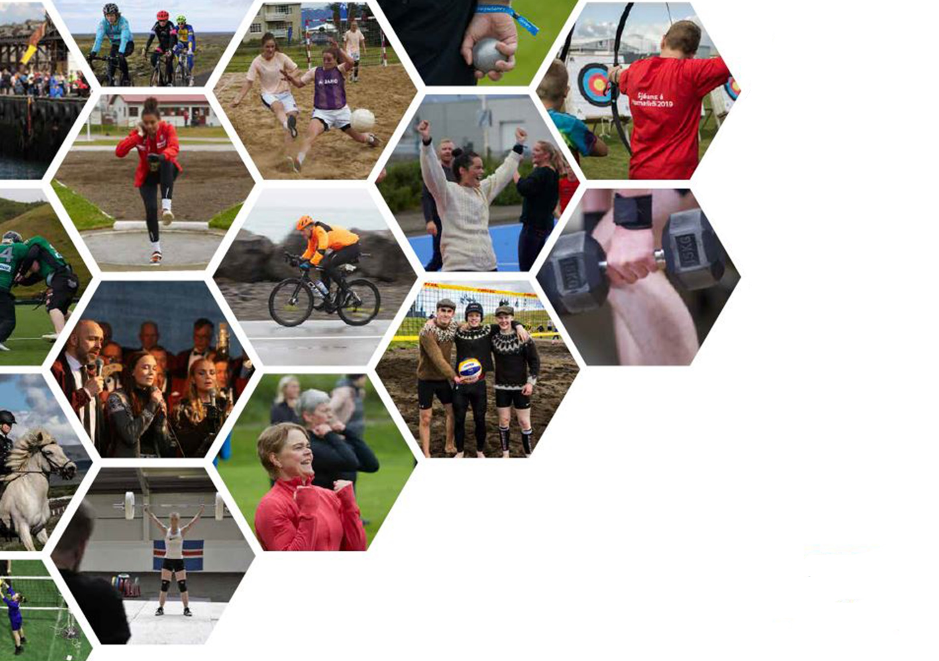
The Icelandic model
Shared Responsibility for the Preparation of the Athlete
Baltic Black Sea Economic forum
Audur Inga Thorsteinsdottir
Notes:
Isnpiration

Slide 2
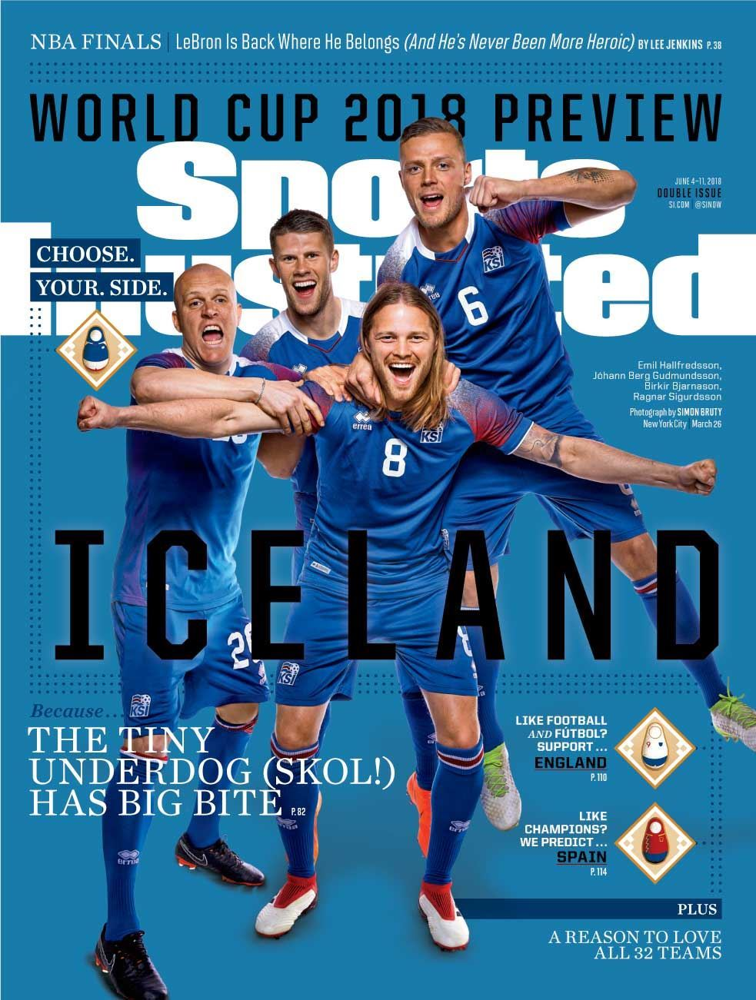
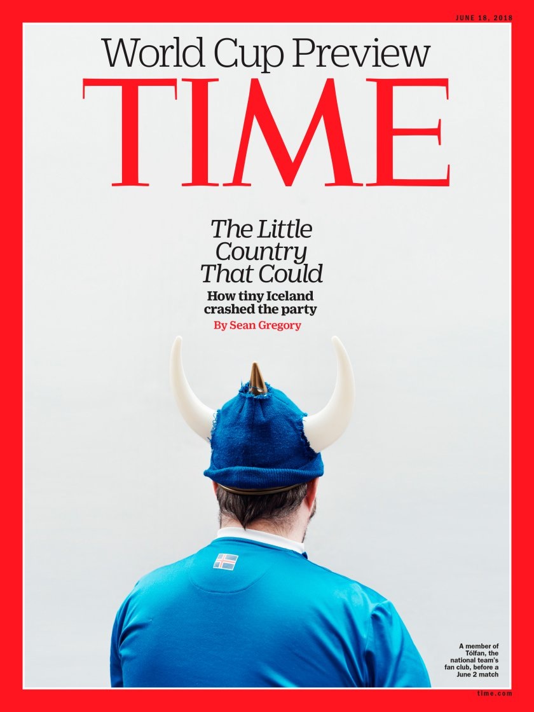
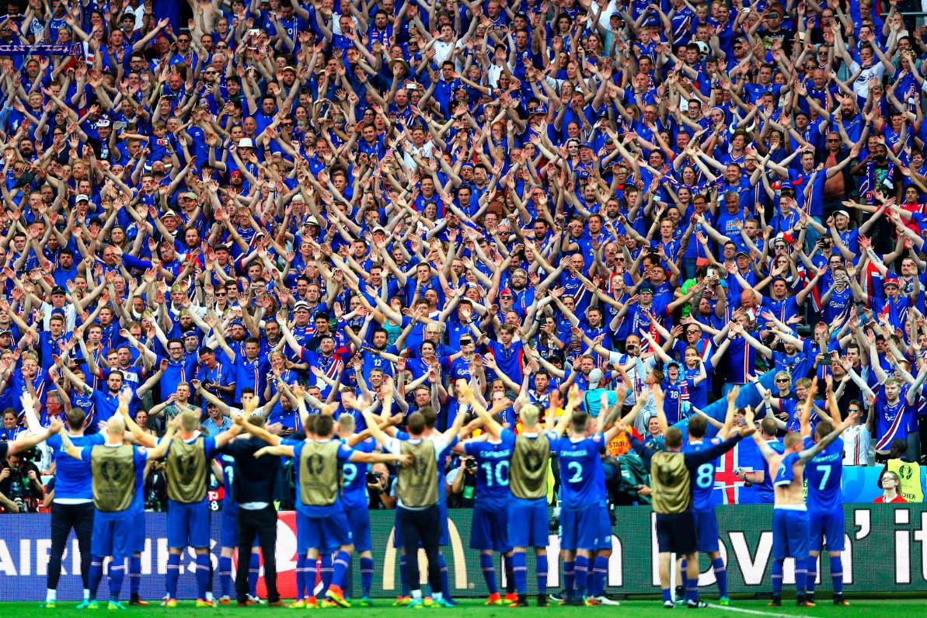
From zero to hero
Key performance factors?
A one time storytail?

Slide 3
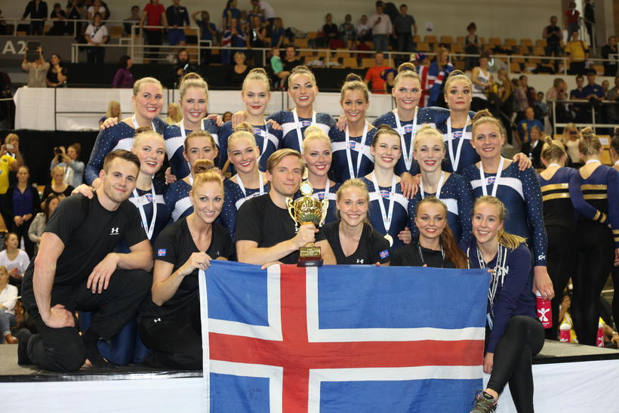
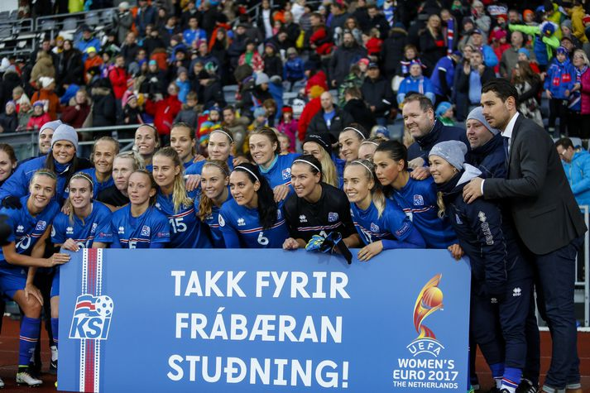
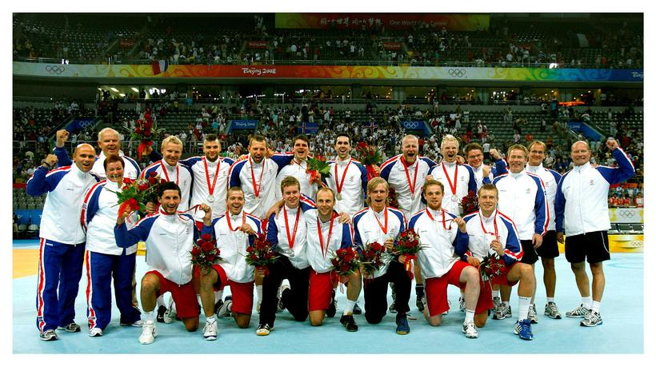
From zero to hero
From 2008 ... Victory road ...

Slide 4
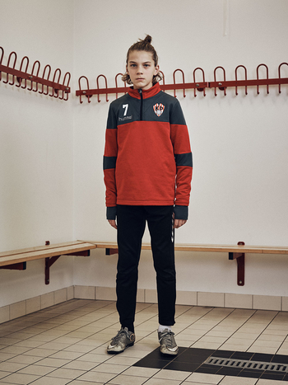
From zero to hero
From worst teenagers in Europe
To best teenagers in Europe

Slide 5
1998 - 2016
42%
23%
5%
3%
23%
24%
46%
42%
Notes:
15-16 ára drykkja síðasta mán 42-5...Reykingar 23-3 .. Samvera með foreldrum 23-46... Æfðu með félagi 4x eða oftar 24-42

Slide 6
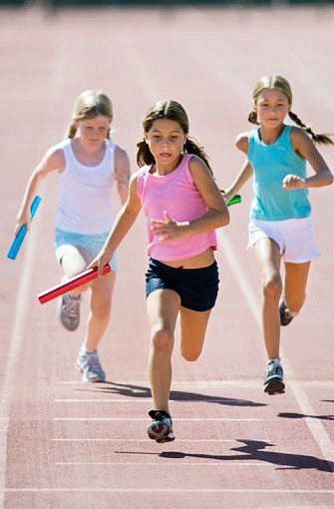
Do and don’t
Protective factors
Participation in organised activities, especially sport
Parents, support, time, information about friends
Not being outdoors in the late evenings.
Risk factors
Peer factors, have friends that smoke etc.
Unstructured activity (hanging out)

Slide 7
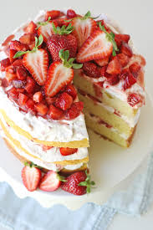
The receipe for success?
Key ingredient
Collaborative effort on various levels
with dash of other important ingredients which can be quite different
Notes:
State level - Lög um útisvistartíma, organizations - aukin fjárframlög til íþróttafélaga, personal level - upplýsingar til foreldra um samveru,

Slide 8
Preparation of athlete
The same premises apply concerning an athlete
Cooperation of different stakeholders where everyone is needed for the best result.
Notes:
State level - Lög um útisvistartíma, organizations - aukin fjárframlög til íþróttafélaga, personal level - upplýsingar til foreldra um samveru,

Slide 9
The more we share
The more we have

Slide 10
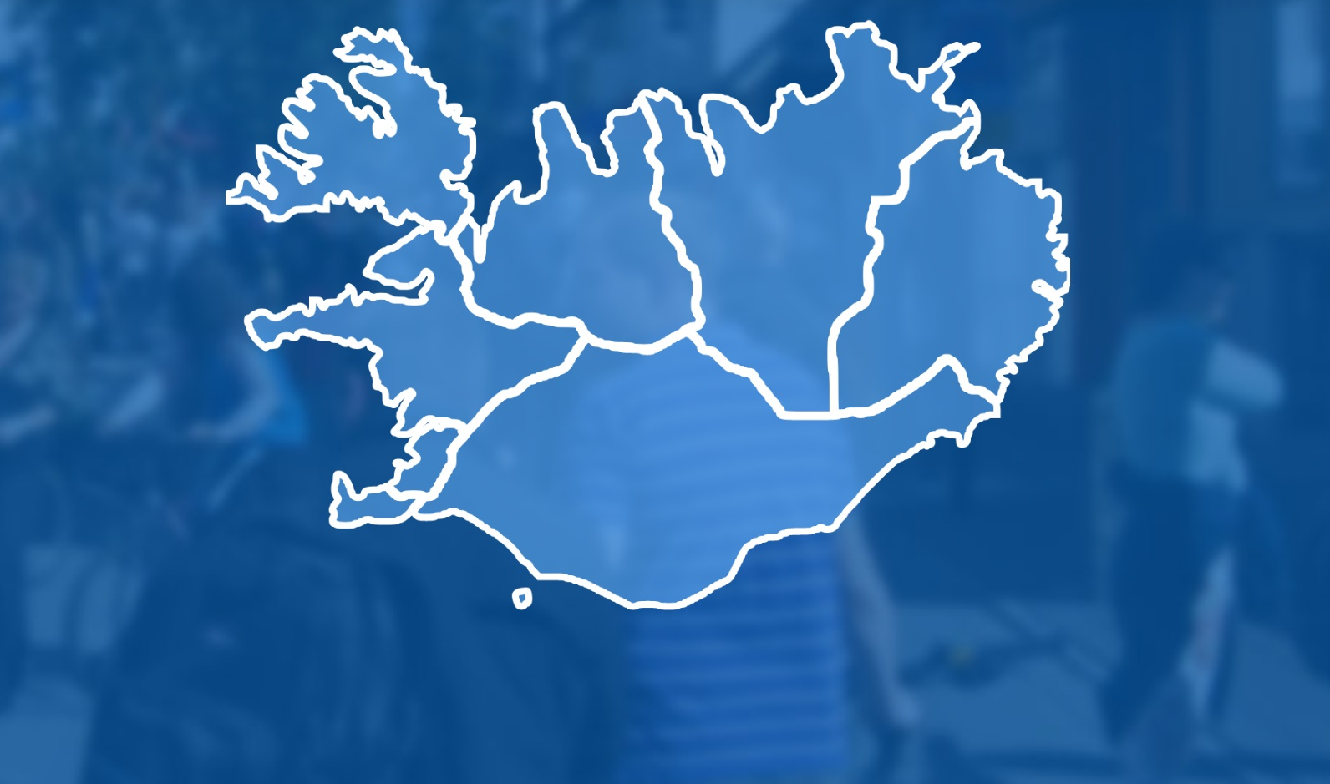
The Icelandic facts
353.070
Residents
1
state
72
Municipalities
25
Sport regions
500
sportclubs

Slide 11
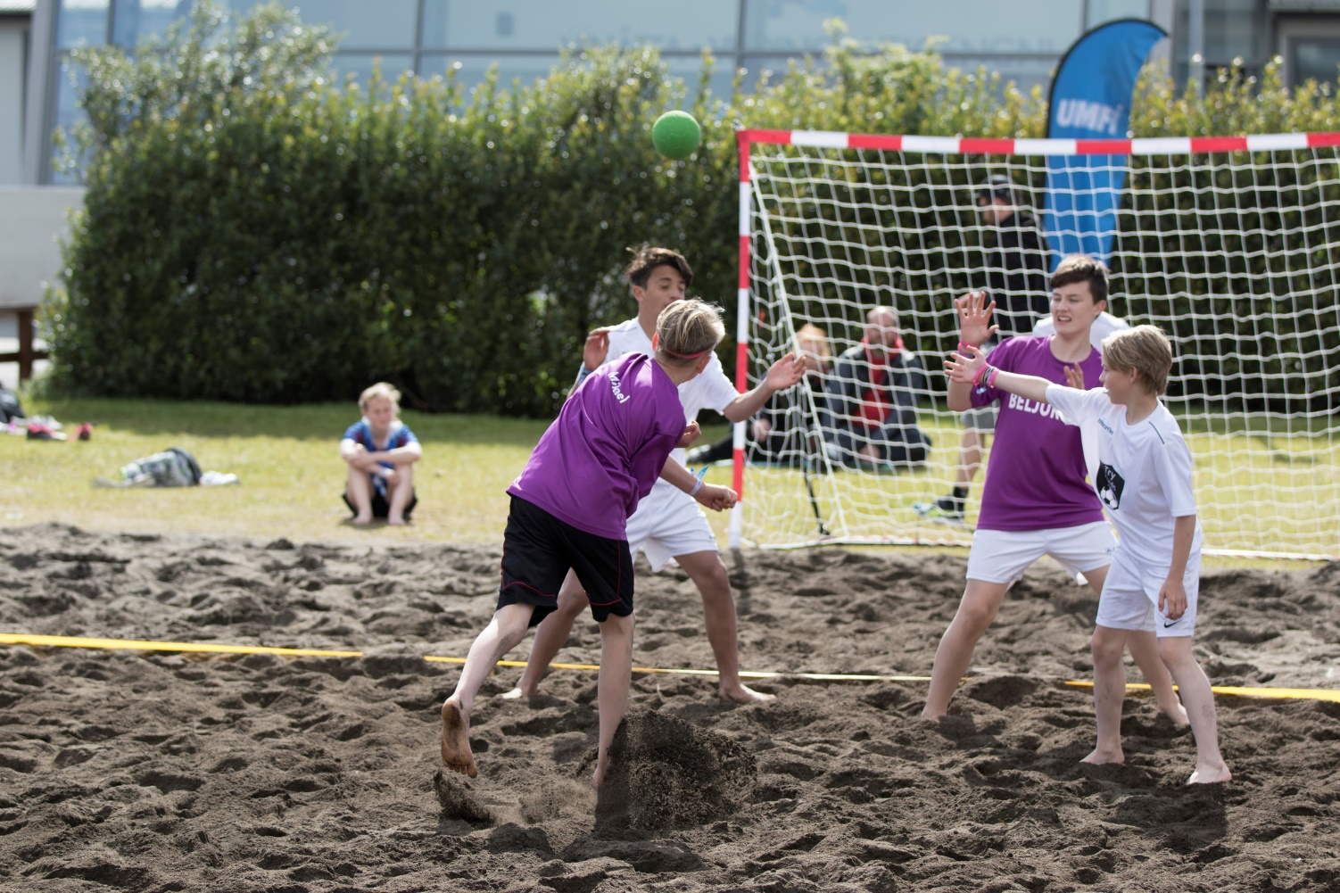
State
Support to national organizations
Annual support through state budget
National lottery license
Elite support
Infrastructure support via projects
Law and policy makers
0,015% of state bugdet
1,2 m.isk of 775 m.isk

Slide 12
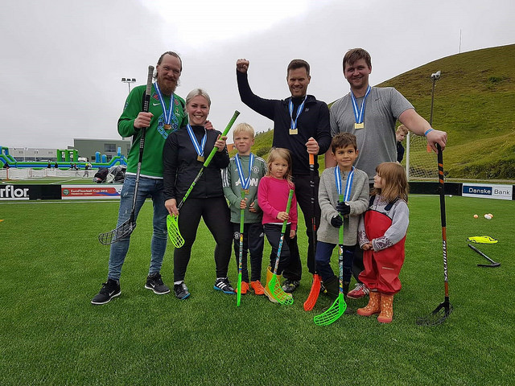
Municipality - 72
Building sport facilities
Support to sport regions & clubs
Support to parents
Project support (elite)
Cooperation with school
Bus to training
Education and courses
Notes:
frístundastyrkur

Slide 13
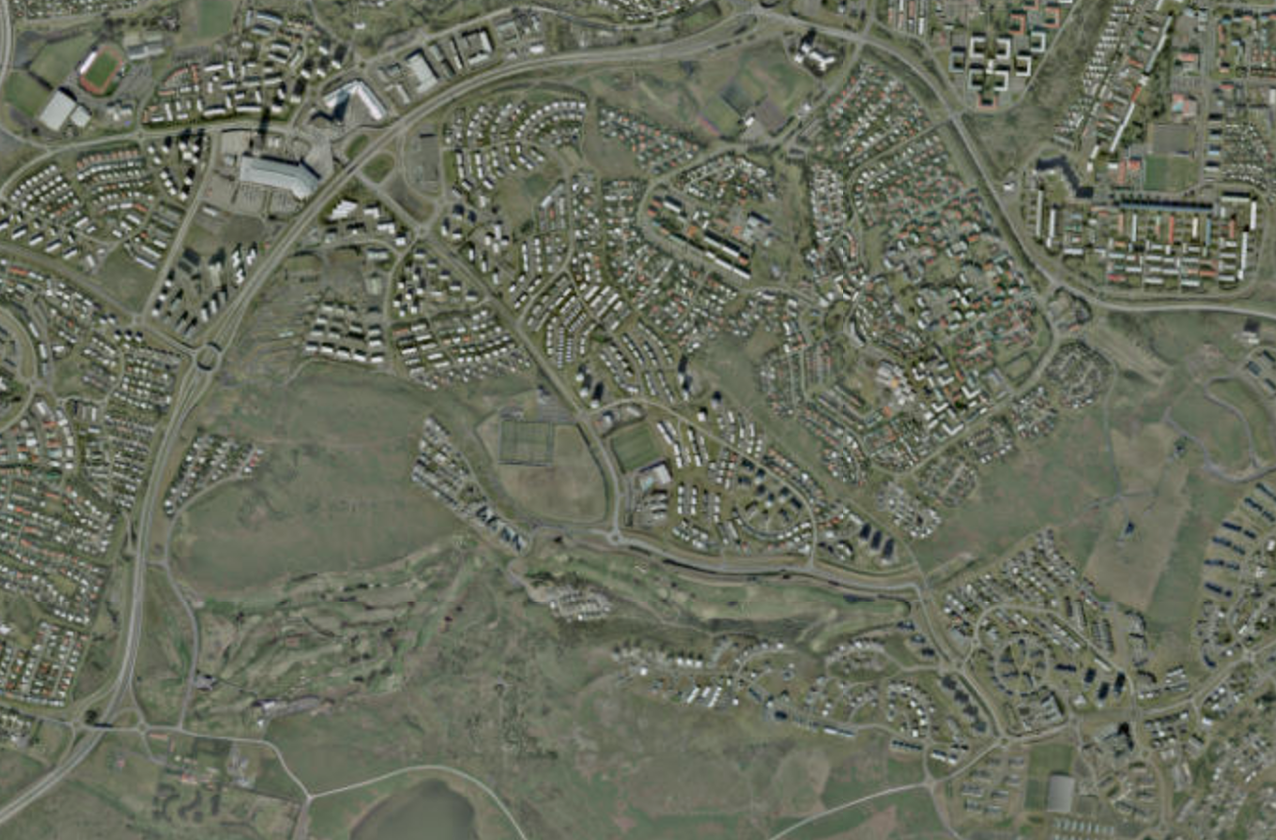
Sports facilities built by municipalities
Constant usage from morning to evening
Most used facilities within the municipality in many places.
Kopavogur municipality
17% of municipality budget
5,6 m.isk
5,3 km
2 Football indoor
8 Football outside
4 Sport halls
3 Swimming pools
3 Gymnastic halls
1 Athletic outside

Slide 14
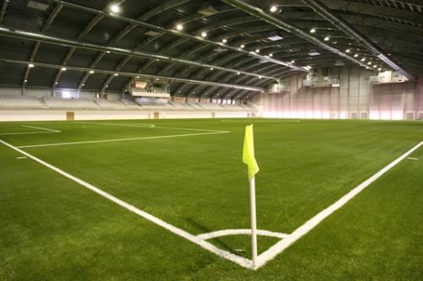
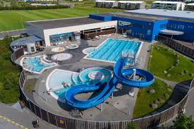
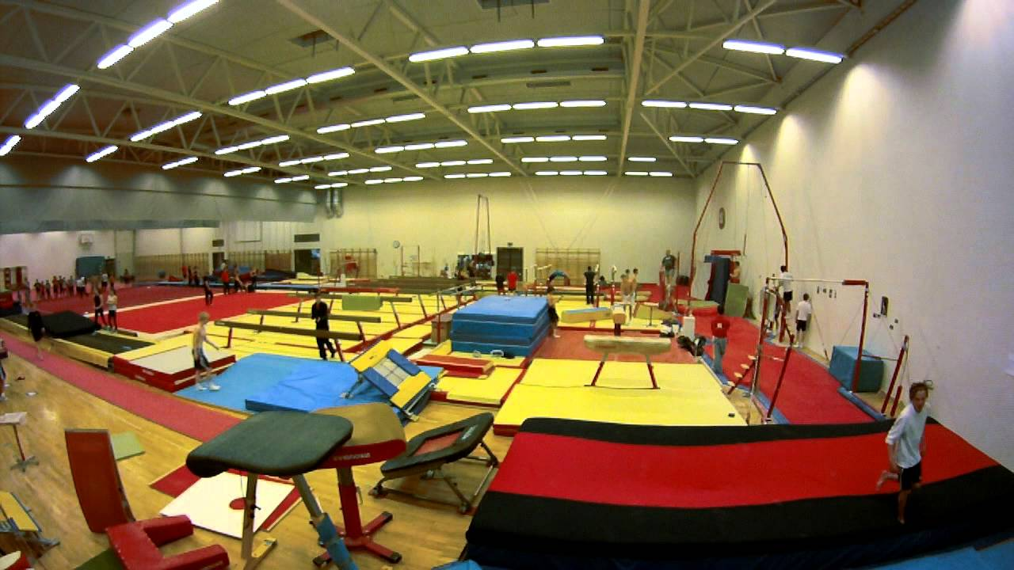
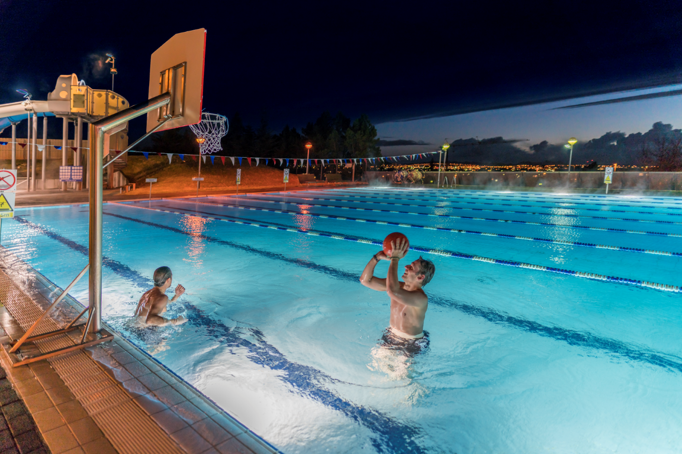
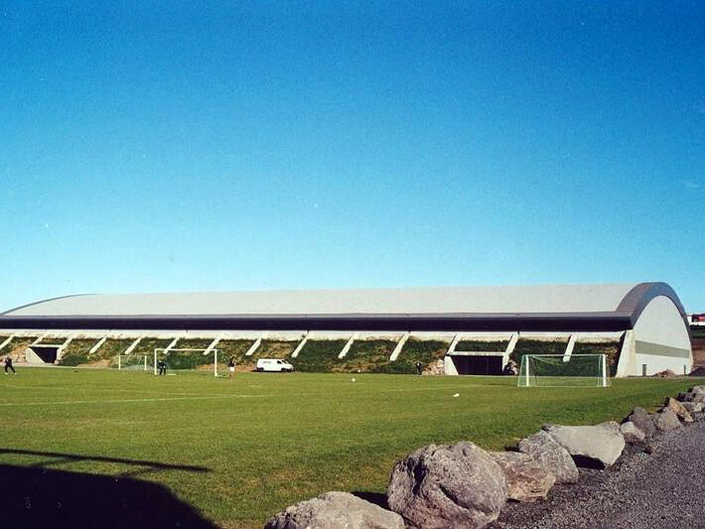

Slide 15
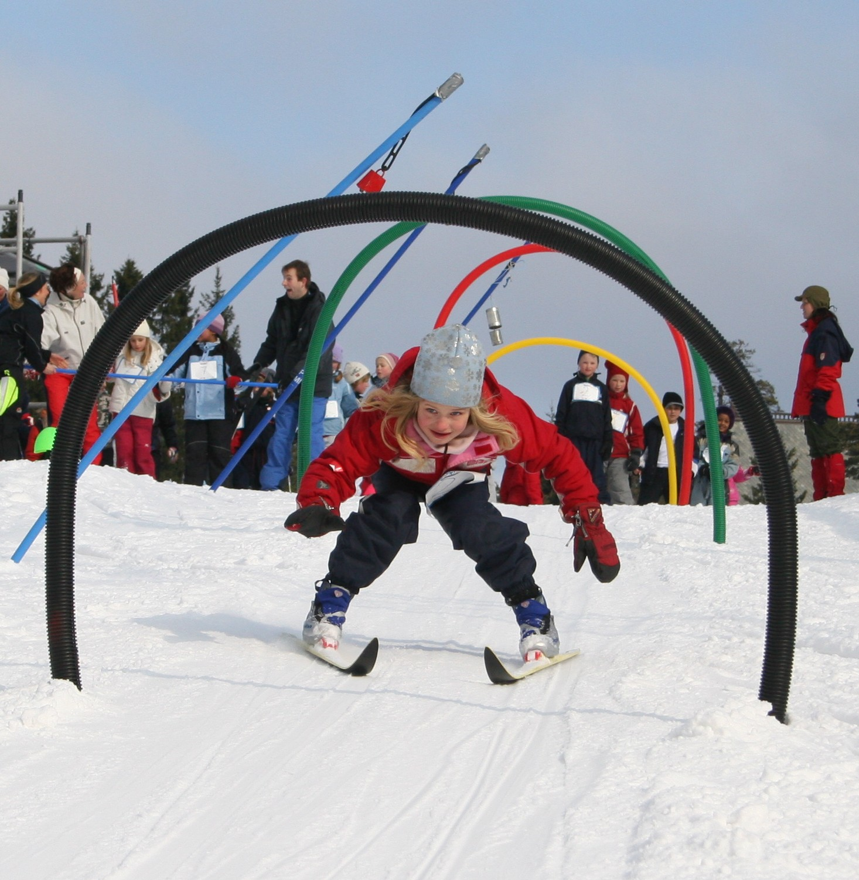
Sport regions -25
Rules & regulation
Education & courses
Coach
Judge
General
Events
Competitions
Licenses

Slide 16
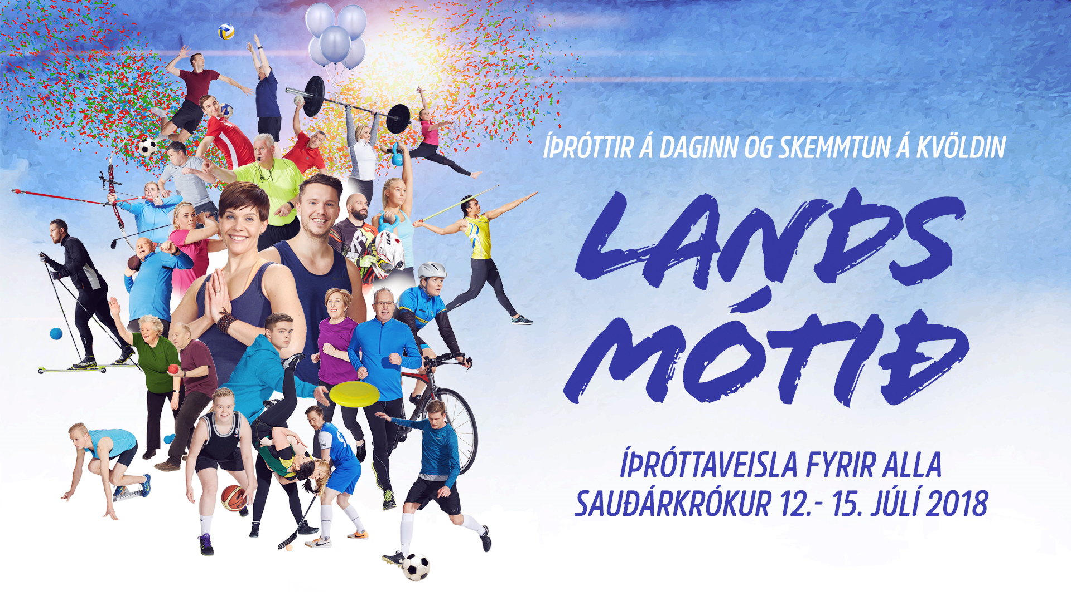

Slide 17
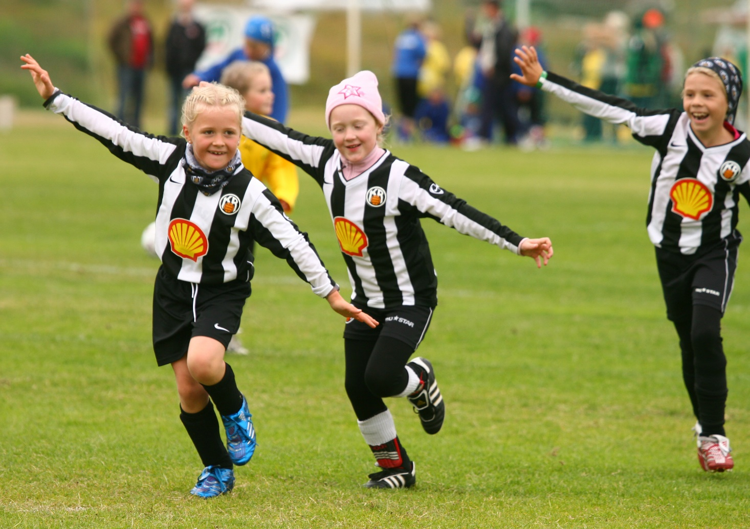
Sport clubs - 500
Activities and various sports
Only non profit clubs
Educational – elite combined
Everyone can participate
Different from countries around us
Can create tension
Notes:
Algjört lykilatriði er skipulagið og bl0ndunin – börnin taka þátt í mörgum íþróttum

Slide 18
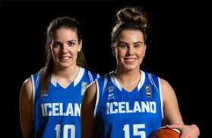
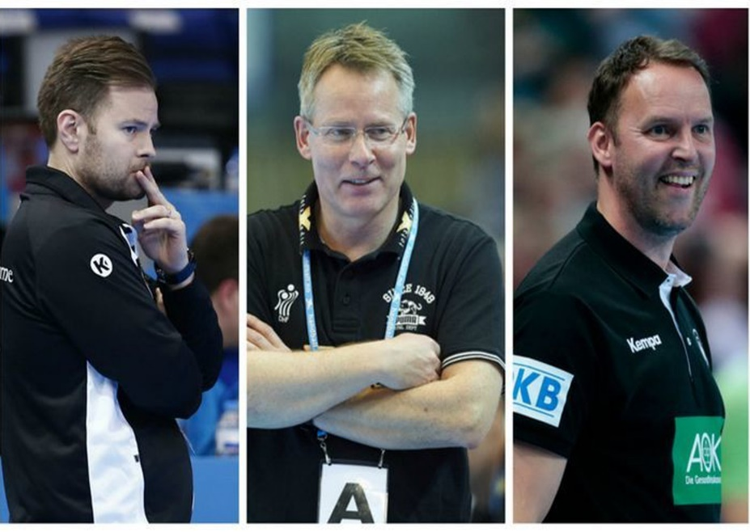
A unique ingredient - Sport culture
The tradition
Facilities
Surroundings and support
Educated coaches
Values
Social wealth
Notes:
Tradition of sport is strong everywhere in Iceland, values of participation where everyone is welcome, berjast fyrir landið og standasaman, social wealth, allir sjálfboðaliðar.

Slide 19
Individual level
Athlete
Training partners
Parents
Coaches
Medical assistance
Social health
Etc.
Notes:
Höfum séð of marga hætta vegna þess að þeir hafa ekki æfingafélaga

Slide 20
Shared responsibility for athlete
Our task as a community is to create circumstances where each individual can improve their skills.
To create the optimised circumstances a wide cooperation is necessary.
Notes:
Tradition of sport is strong everywhere in Iceland, values of participation where everyone is welcome, berjast fyrir landið og standasaman social wealth, allir sjálfboðaliðar.

Slide 21
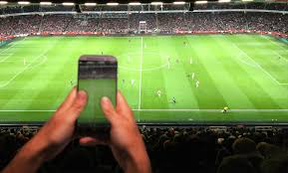
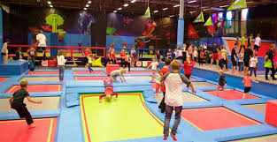
Trend
To keep track and continiously improve thinking ahead is good.
Trend - A way to define possibilities and new opportunities.
Not an answear for the future, but more like a guideline.

Slide 22
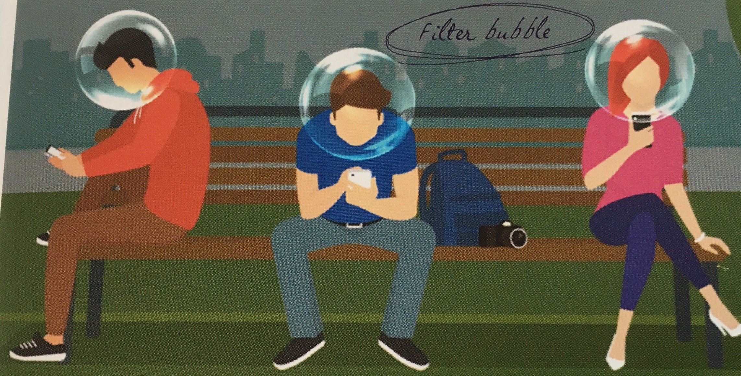
„Our own bubble“

Slide 23
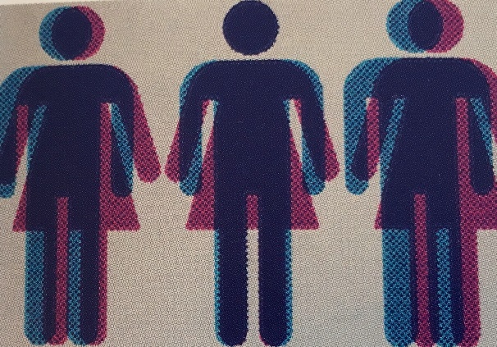
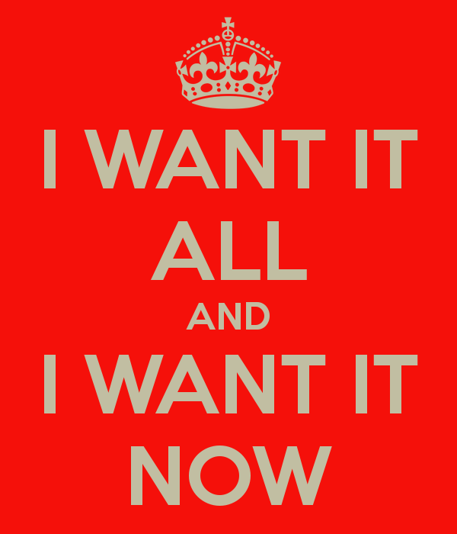
Global world
Information overload
Connectivity
Internet of everything
Borders fade out
Speed & demand, new today old tomorrow

Slide 24
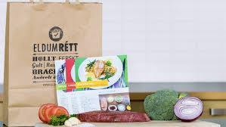
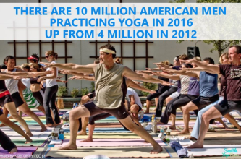
On my terms
When I want to, like I want to
Personalised, flexible
Online, apps etc

Slide 25
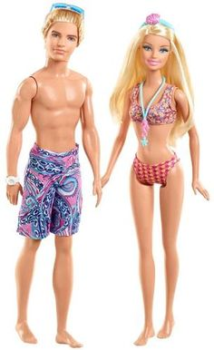
Not the same for everyone
Notes:
Samfélagið hefur breyst.. Define frá áhugasviði frekar en aldri kyni.. Hlustað á fleiri. More options.. Health as a goal rather than results. Það skapar nýjar þarfir og nýjar kröfur

Slide 26
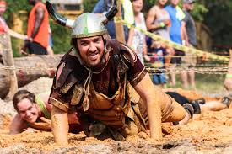
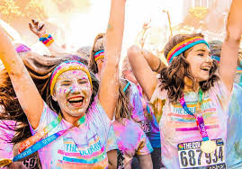
Experience & memories
Tell me and I forget, teach me and I may remember.
Be part of a a story
To feel that you are alive

Slide 27
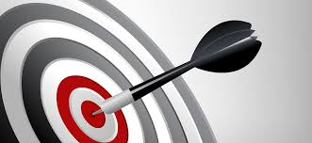
Professionalism & marketing
Improved demands
Marketing of sport
What to we say
How to we say it

Slide 28
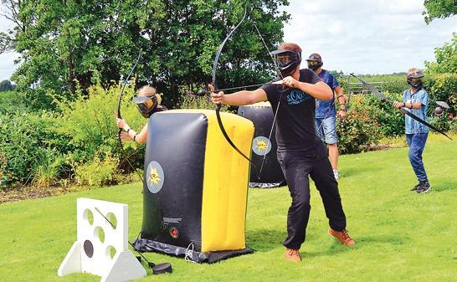
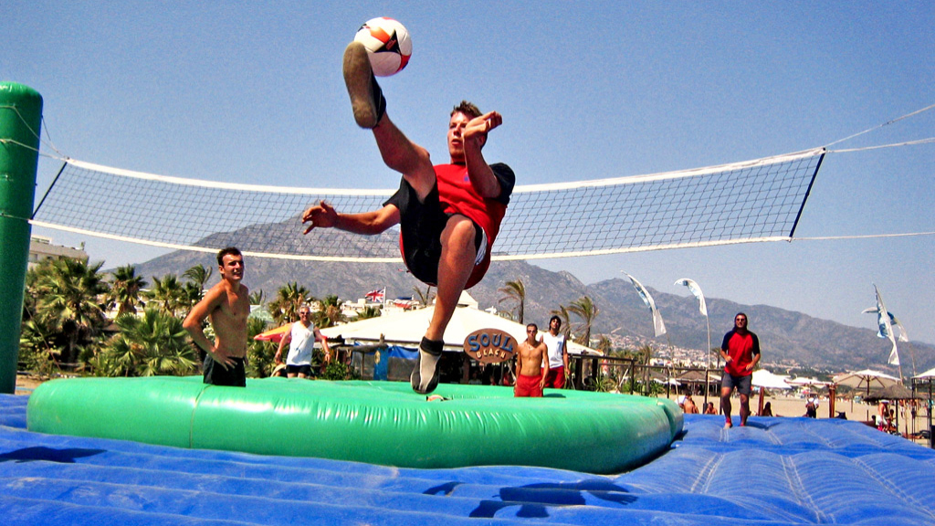
What does the trend mean?
What consequences does it have...
Do more
Do the same
Do less / quit

Slide 29
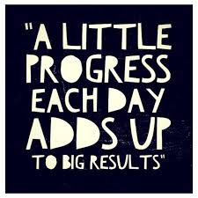
What is happening?
Huge changes is society today
Building bridges and sharing has never been as important as today
What needs are out there?
What we stand for (and therefore what we don’t)
Structure to be able to take actions fast.
Decide, because if you dont everyone else will decide for you
Create the magic moment

Slide 30
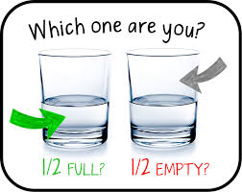
Good luck sharing,
Changes have never occured because of those who said: it is not possible.
Bertrand Piccard, a doctor who flew a solarenergy airplane around the world.

