Slide 1
Workshop:
Sport infrastructure development at local level
Dr. Remco Hoekman
Senior researcher, Mulier Institute / Radboud University
26 October 2018
Klaipeda, Lithuania

Slide 2

Structure workshop
1. Introduction in sport system (in the Netherlands)
2. Key elements in local policies on facilitating sport
3. Distribution of sport facilities
4. Instruments to measure and prospect demands for
sport facilities
5. Considerations and implications for local sport
infrastructure development
@RemcoHoekman

Slide 3
Why sport policy?
Leisure time, own responsibility?
Social right – Sport for All (market failure)
Benefits of sport for the individual and for society
Facilitate sport participation
influence behaviour
@RemcoHoekman

Slide 4
Relevance of facilitating sport
European Sport for All Charter (Council of Europe, 2001)
“the scale of participation in sport is dependent in part on the extent, the variety and the accessibility of facilities”.
Sport requires space
@RemcoHoekman

Slide 5
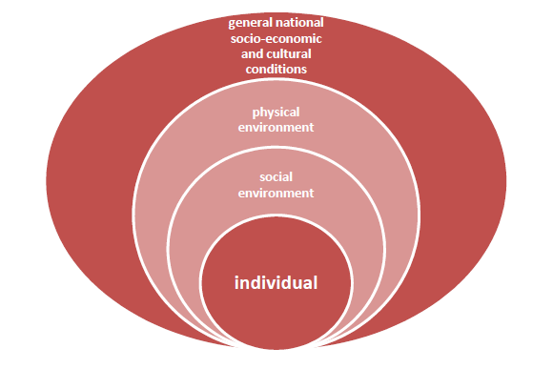
Socio-ecological model (Bronfenbrenner 1979)
“Not one factor or set of factors adequately accounts for why people act as they do”
Source: Van Tuyckom 2011
@RemcoHoekman

Slide 6
Development of sport facilities in the Netherlands
Swimming pool
@RemcoHoekman

Slide 7
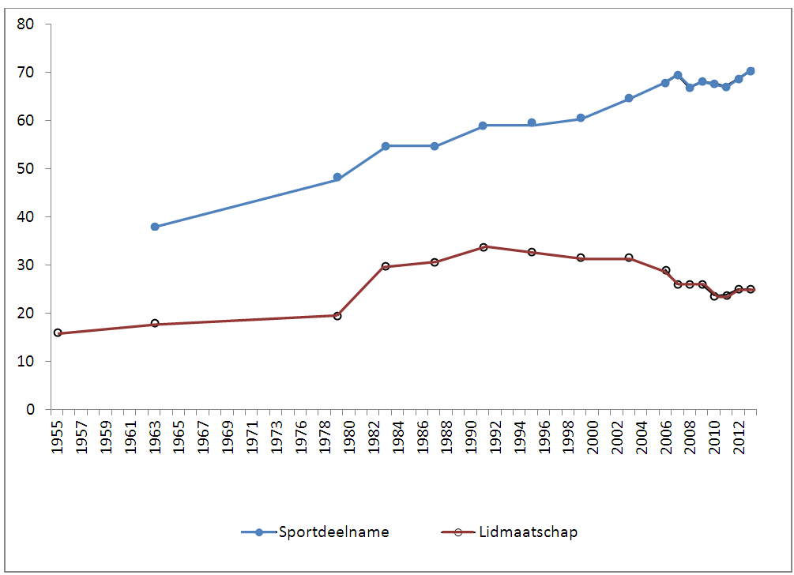
Increase in sport participation
Sport participation
Sport club membership
Source: Breedveld (2014), Sportparticipatie, uitdagingen voor wetenschap en beleid (Radboud Universiteit)
@RemcoHoekman

Slide 8
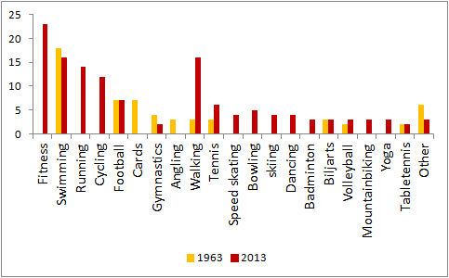
… change in participation
Source: K. Breedveld (2014), Sportparticipatie, uitdagingen voor wetenschap en beleid (Radboud Universiteit)
@RemcoHoekman

Slide 9
Facility use for sport practices
Use of types of facilities for sport participation, 2011 and 2014, Dutch population, 6-79 years old (in percentages)
@RemcoHoekman

Slide 10
Dutch context
No legal obligations for sport – division of responsibilities to governmental levels
Municipalities: responsible for facilitating sport
Provinces: supporting local programs
National: national sport infrastructure, monitoring developments, initiate new initiatives
Sport as an instrument – societal value of sport
Prevention / health / youth / education / integration / etc.
Coördinating government
Sport policy result of cooperation policy partners
Social system: co-creation, participation society, added value of sport
Historical development explains current situation
@RemcoHoekman

Slide 11
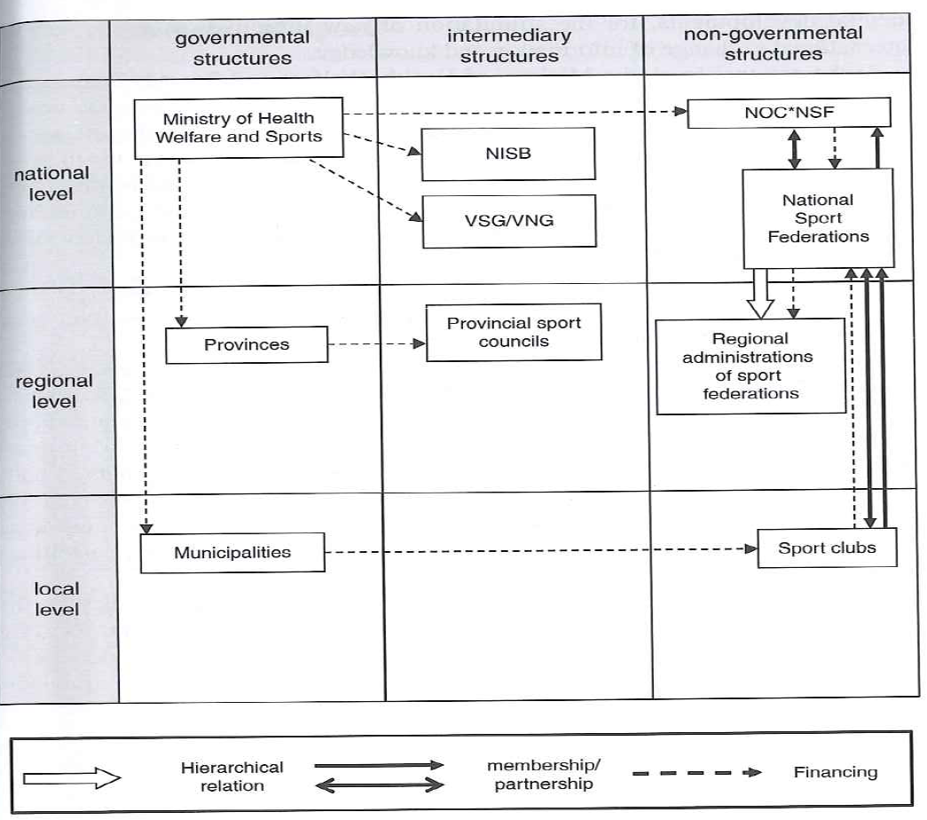
Dutch sport system
Based on Hoekman & Breedveld (2013).
@RemcoHoekman

Slide 12
Sport in the Netherlands
@RemcoHoekman

Slide 13
Understanding local sport policy
Changing discourse in local sport policy
Focus on instrumental value of sport
Health of population as main objective rather than sport participation
Sport budget mainly dedicated to sport facilities
Do sport facilities contribute to sport participation?
How can we improve the utilization of sport facilities, or the costs involved?
Austerity
Limited influence on sport budgets, contrary to the eighties
Increased emphasis on effective and efficient sport policy
More attention for utilizing the market or ‘civil society’
Sport profits from naturalized belief in goodness of sport
@RemcoHoekman

Slide 14
Content local sport policy
Effective and efficient policies on sport infrastructure
optimal use of sport facilities
utilizing the present ‘local sporting capital’
continuous development of the local sport infrastructure
Bigger role for voluntary sport clubs
Important local partner
More responsibilities: policy projects and running/operating sport facilities
Utilizing the instrumental value of sport
Connect with other policy domains
Attention for specific target groups
Initiating new programs and cooperation
@RemcoHoekman

Slide 15

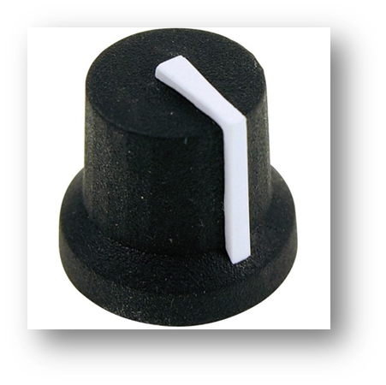

Policy on sport facilities
Quality / modes of operation
Capacity / distribution
Fees
@RemcoHoekman

Slide 16
Good distribution in NL
Source: Hoekman et al. (2016) Landscape of sport facilities in the Netherlands
@RemcoHoekman

Slide 17
Distance to sport facilities
Distance in km to nearest sport facility, average per type of facility for Dutch population.
 | fitness | golf | hockey | korfball | sporthall | tennis | football | Swimming pool
Netherlands | 1,5 | 6,3 | 4,4 | 4,1 | 1,6 | 1,6 | 1,6 | 2,3
@RemcoHoekman

Slide 18
Distribution
Distance to sport facilities
Source: Hoekman et al. (2016) Landscape of sport facilities in the Netherlands
@RemcoHoekman

Slide 19
Importance of database for sport facilities
Importance of sport facilities as policy instrument
Study on knowledge infrastructure on sport illustrated lack of information on presence of sport facilities
Official key indicator of national sport policy
@RemcoHoekman

Slide 20
Content database
Over 20.000 sport facilities in database (nearly all)
Linked with database of sport providers
All facilities | Some of the facilities
Address information | Number of fields/lanes/pitches
X-,Y-coördinaten | Accessibility (swimming pools)
Type of sport | Sport provider (VSCs)
Indoor/outdoor | Surface
Type of facility | Facility operator
Date of entry | Year of foundation
… | …
@RemcoHoekman

Slide 21
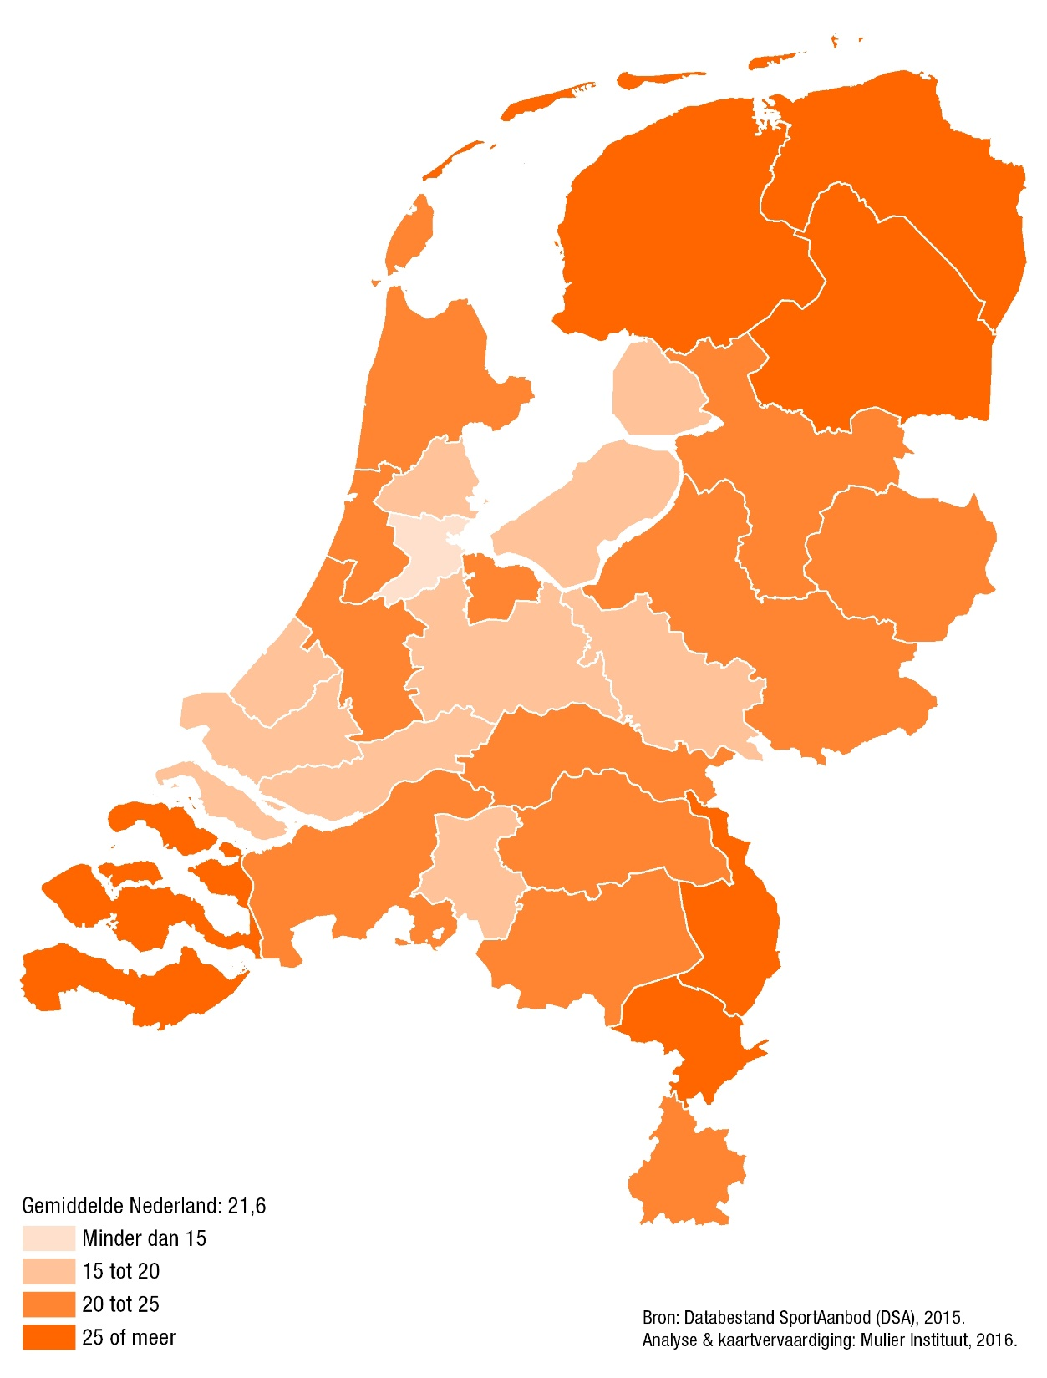
Core indicator
Sport facilities

Slide 22
Capacity issue tool to calculate current and future need
Onderdelen
Current supply
Occupation rate and current demand
Trends and developments and future demand
Policy implications
Insight in demand
Outdoor sports
Indoor sports
Swimming pools
Public space
@RemcoHoekman

Slide 23
Approach
Utilizing planning instruments and accepted guidelines
Bandwidth for future perspective (min – max)
Benchmarking
Core indicators
Analysis of occupation rates
Calculate travel distances and catchment areas
User surveys
@RemcoHoekman

Slide 24
Outdoor sports – norms / guidelines
Example of study in municipality of Veldhoven (45.000 inwoners)
Needs assesment football club, season 2016/2017
 | No. Teams |  |  | Needed no. Match pitches |  |  | Indication year use in hours
 | No. teams | No. Standardized teams |  | Organisational | Technical |  | Matches | Practice
Saturday | 23 | 11,9 |  | 2,1 (3) | 1,7 (2)
Sunday | 8 | 8,0 |  | 1,2 (2) | 1,1 (1)
Total | 31 | 19,9 |  | 2,1 (3) | 2,2 (2) |  | 558 | 1.095
@RemcoHoekman

Slide 25
Outdoor sports – future perspective
Example research Veldhoven
Bandwidth (future) needed no. Standardized teams fieldhockey
@RemcoHoekman

Slide 26
Example: Indoor sports facilities
Optimalization of presence and use of indoor sport facilities
Standard multi-sport facilities (i.e. no sport specific facilities)
  Suited for physical education in the Dutch system
Distinguish three types of indoor sports facilities: large, medium & small
@RemcoHoekman

Slide 27
Types of indoor sports facilities
Large (44 x 24)
Medium (28 x 22)
Small (21 x 12)
@RemcoHoekman

Slide 28
Planning Instruments
Dutch Planning Statistics (Planologische Kengetallen)
  Development standards (i.e. number of inhabitants per facility)
  Large indoor sports facility: 1 facility per 15.000 – 20.000 inhabitants
Medium indoor sports facility: 1 facility per 10.000 – 12.500 inhabitants
Small indoor sports facility: 1 facility per 3.000 inhabitants (based on legislation task for physical education)
@RemcoHoekman

Slide 29
Dutch Sport Facility Database
Over 20.000 sport facilities
  Covers almost all facilities in The Netherlands
Table 1 – Number of indoor sports facilities in The Netherlands (DSA, 2016)
 | Large facilities | Medium facilities | Small facilities
N | 1,841 | 689 | 4,100
Actual presence | 1 per 9.000 | 1 per 25.000 | 1 per 4.000
Guideline / norm | 15.000-20.000 | 10.000-12.500 | 3.000
@RemcoHoekman

Slide 30
Dutch Usage Statistics
Dutch Sports Federation Guideline (NOC*NSF)
  Minimum desired sport usage on a annual basis:
  35 weeks * 40 hours = 1.400 hours
Association of Dutch Municipalities Guideline (VNG)
  Minimum desired usage on a annual basis (including physical education)
  40 weeks * 40 hours = 1.600 hours
@RemcoHoekman

Slide 31
Dutch Planning Statistics
Figure 1 – Number of Dutch municipalities and the ratio between indoor sports facilities presence and theoretical need (DSA, 2016)
The presence of indoor sports facilities in the majority of Dutch municipalities exceed the theoretical need
@RemcoHoekman

Slide 32
Benchmark Usage Sport
Facilities
Contains usage data indoor sports facilities from 30 Dutch municipalities
  98 large indoor sports facilities, 47 medium facilities & 233 small facilities
Contains the date, time, user & activity from every usage
@RemcoHoekman

Slide 33
Usage guidelines
Figure 2 – Number of indoor sports facilities that meet the guidelines
The greater majority of the facilities do not meet the guideline from the Dutch Sports Federation
  A significant amount also doesn’t pass the Association of Dutch Municipalities guideline
@RemcoHoekman

Slide 34
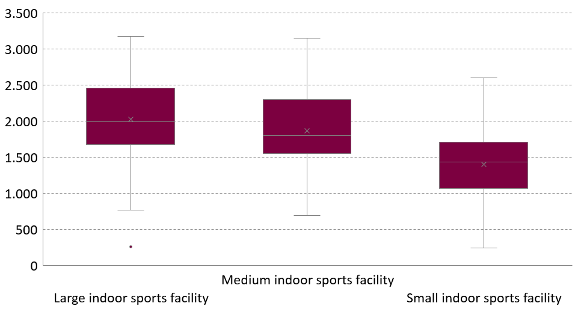
Annual usage
Figure 3 – Distribution annual usage indoor sports facilities, in hours
@RemcoHoekman

Slide 35
Usage by month
Figure 4 – Average occupancy rate large indoor sports facilities, by month, in %
Gradual increase occupancy rate towards winter months
  Distinguish regular period/season (March-November) and winter period/season (January, November & December)
@RemcoHoekman

Slide 36
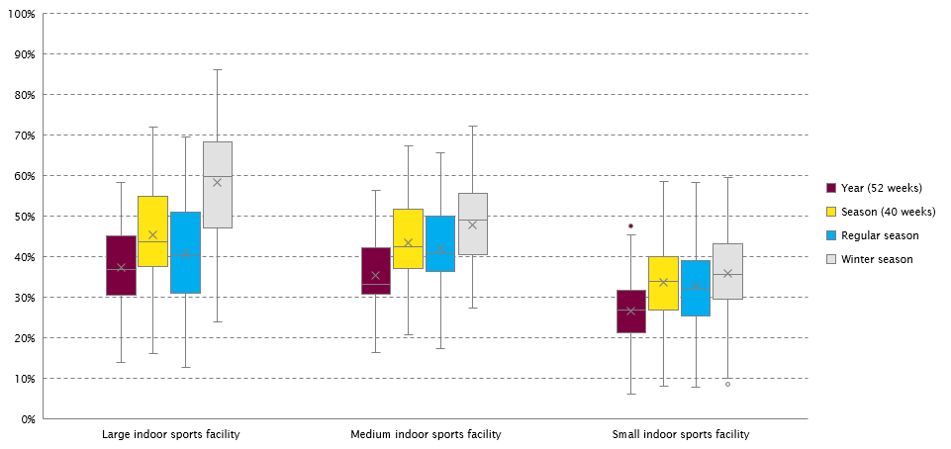
Usage by period
Figure 4 – Distribution occupancy rate indoor sports facilities, by period, in %
Relationship between size indoor sports facility and increase winter season vs. regular season
@RemcoHoekman

Slide 37
Usage by hour
Figure 5 – Average occupancy rate on weekdays large indoor sports facilities, per hour, in %
@RemcoHoekman

Slide 38
Usage by hour
Figure 6 – Average occupancy rate weekend large indoor sports facilities, per hour, in %
@RemcoHoekman

Slide 39
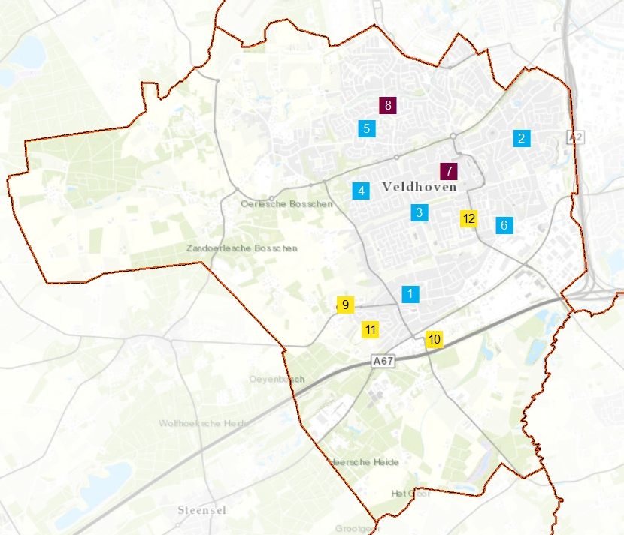
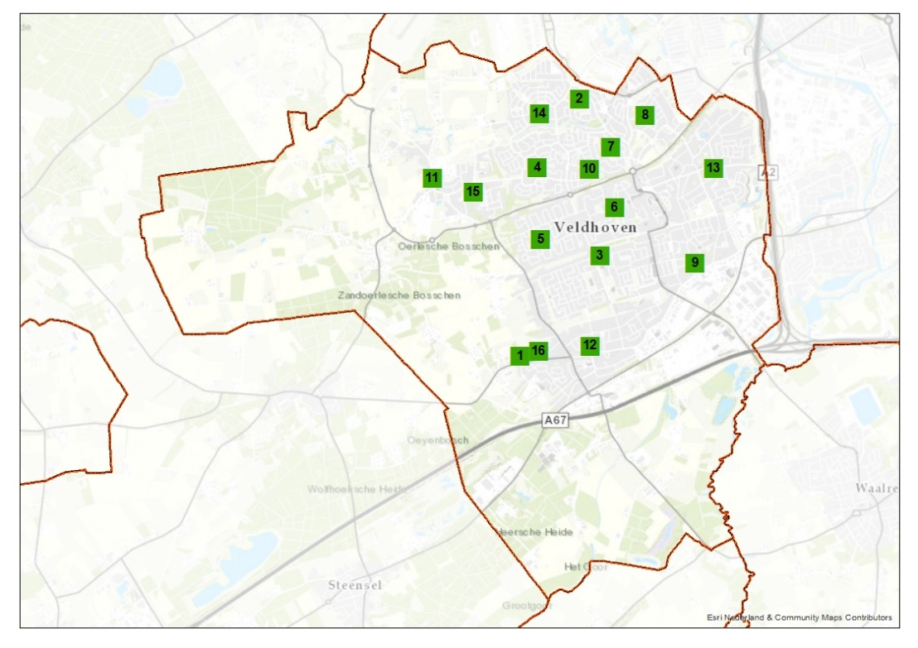
Indoor sports –
Analysis of travel distances
Example of municipality
Overview indoor sport facilities
Overview educational facilities
@RemcoHoekman

Slide 40
Policy implications: optimizing the configuration of sport facilities
Tailor-made on a local level
Case football facilities
Beneficial aspects of sport facilities in small communities
@RemcoHoekman

Slide 41
Case football facilities
Decline number of football clubs and facilities
Clustering / larger facilities
Seperation by religion does not fit with current society
Considerations in light of contribution to liveability
Optimizing use by artificial grass
More members per pitch
Fits with higher quality standards of members
@RemcoHoekman

Slide 42
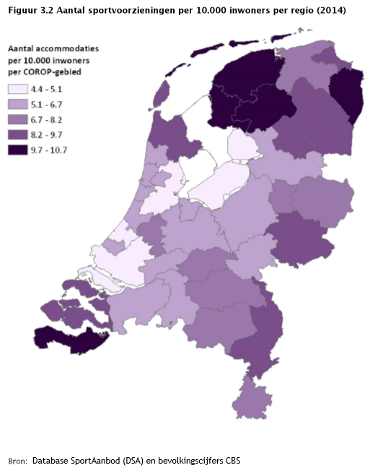
Sport facilities in small communities
Importance liveability
More but smaller facilities
Division Dutch population and sport clubs by region (%)
Population
Sport clubs
Anticipated decline
Other
@RemcoHoekman

Slide 43
Broader use of municipal sport facilities
Municipal sport facilities, still relevant:
Use of sport fields, importance physical education (sport halls) and swimming abilities (swimming pools)
Need to adapt to changing society and focus more on usage by older age groups
NOC*NSF: promotion ‘open club’ > sport club and facility that are open to society and appeal not only to members. Function as a public facility, cooperate with other organisations in and outside the sport sector.
@RemcoHoekman

Slide 44
Increasing importance of public space both in rural and urban areas
Urban areas: youth and young adults (running/jogging, cycling, urban sports, bootcamps, football, etc.)
Rural areas: older population (cycling, walking, fishing, etc.)
Healthy and active lifestyles: health-enhancing physical environment
More attention for sport-use of public space in local sport policy
ISCA awards 2018: MOVEment spaces
@RemcoHoekman

Slide 45
Not one most effective mode of operation
Wide variety of different modes of operations of sport facilities
Sport clubs can play a bigger role, however also limitations
Increasing involvement of the market and civil initiatives
More coordinating role of the government or regaining control to be able to stimulate broader usage and links with other policy domains.
@RemcoHoekman

Slide 46
Broad focus on sport facilities in sport policy
Quality / modes of operation
Capacity / distribution
Fees
multifunctionality demand-supply cover larger part of the costs
sustainability clustering solve unequality
privatisation travel distance system of fees
Maintenance affordable sport facilities
@RemcoHoekman

Slide 47
Relevance of sport facilities for sport participation
Local sport policy is about facilitating sport, influencing and facilitating behaviour.
Can we explain differences in sport participation, by differences in the physical environment (presence and variety of sport facilities)?
National research departing from difference rural and urban areas
@RemcoHoekman

Slide 48
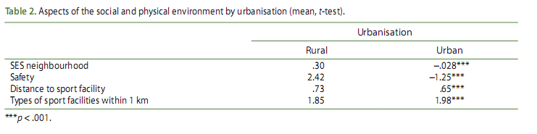
Differences in social and physical environment between urban and rural areas
@RemcoHoekman

Slide 49
Findings
Higher weekly sport participation in rural areas
Rural-urban divide explained by social environment, not physical environment
Variety in sport facilities important for monthly sport participation (not for weekly sport participation)
Distance to sport facilities provides no explanation for differences in sport participation
@RemcoHoekman
Klaipeda, Lithuania

Slide 50
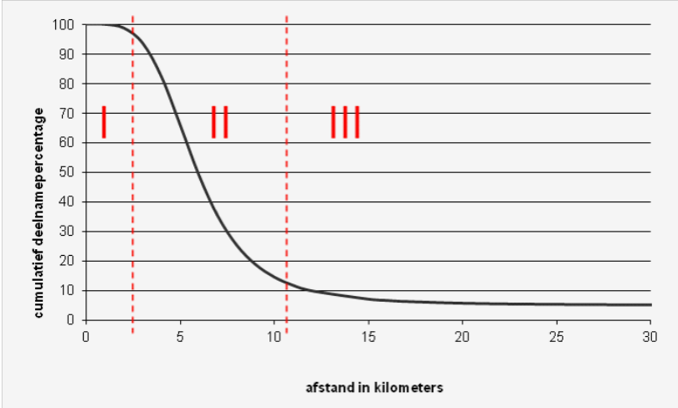
Willingness to travel
@RemcoHoekman

Slide 51
Discussion and implications
Social factors most important
Sport facilities provide some explanation, particularly for those less motivated
Benefical context of the Netherlands
Effect of sport facilities assumed to be bigger in other countries.
However, never-ending attention for matching supply and demand
Development of sport preferences and sporting landscape
Improving the utilization of sport facilities
Lowering the municipal sport expenditures on sport facilities
@RemcoHoekman

Slide 52
Utilizing local sport capital
Optimizing combination of sporting capital
Hardware (physical environment, sport facilities)
Orgware (sport providers)
Software (programs, activities)
What is optimal depends on context and intended objective
local demand
Specific target groups
Objectives (elite sport, grassroots sport, social welfare, health)
Changes through time
Societal trends have consequences for sport sector and ask for continuous adjustments of policy and responses to changing demands of the population
@RemcoHoekman

Slide 53
Connecting local sport infrastructure to needs of population
Hardware (environment, facilities)
Orgware (providers) Software (programs, activities)
@RemcoHoekman

Slide 54
To conclude:
Data as important starting point
supply, demands, current usage, trends
Different roles for local authorities, sport providers, civil initiatives, market etc.
cooperation needed between parties and departments (e.g. with education)
What needs to be done depends on local situation and set objectives
Continuous need to adapt to changing society
Instruments and good examples available in other countries
@RemcoHoekman

Slide 55
Questions, remarks, points for discussion?
Dr. Remco Hoekman
r.hoekman@mulierinstituut.nl
@RemcoHoekman
Klaipeda, Lithuania

