Slide 1
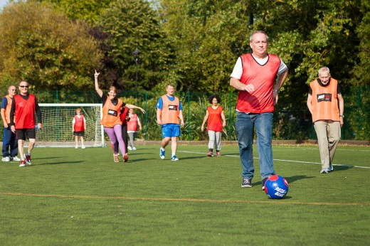
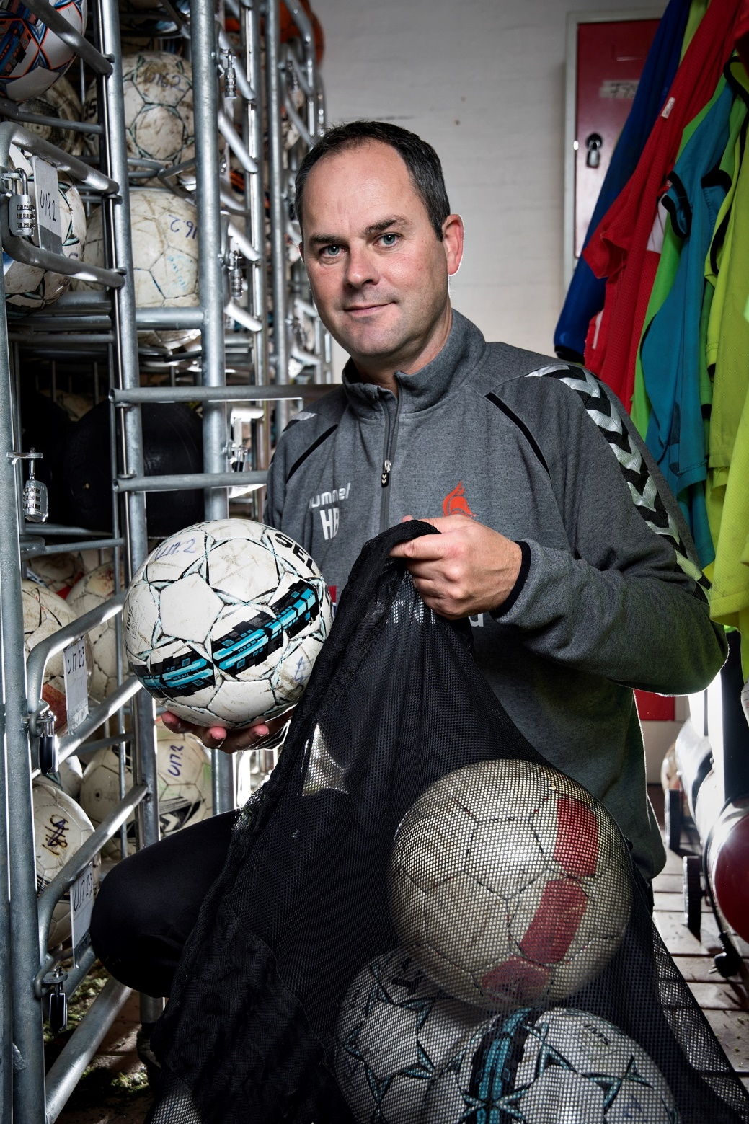
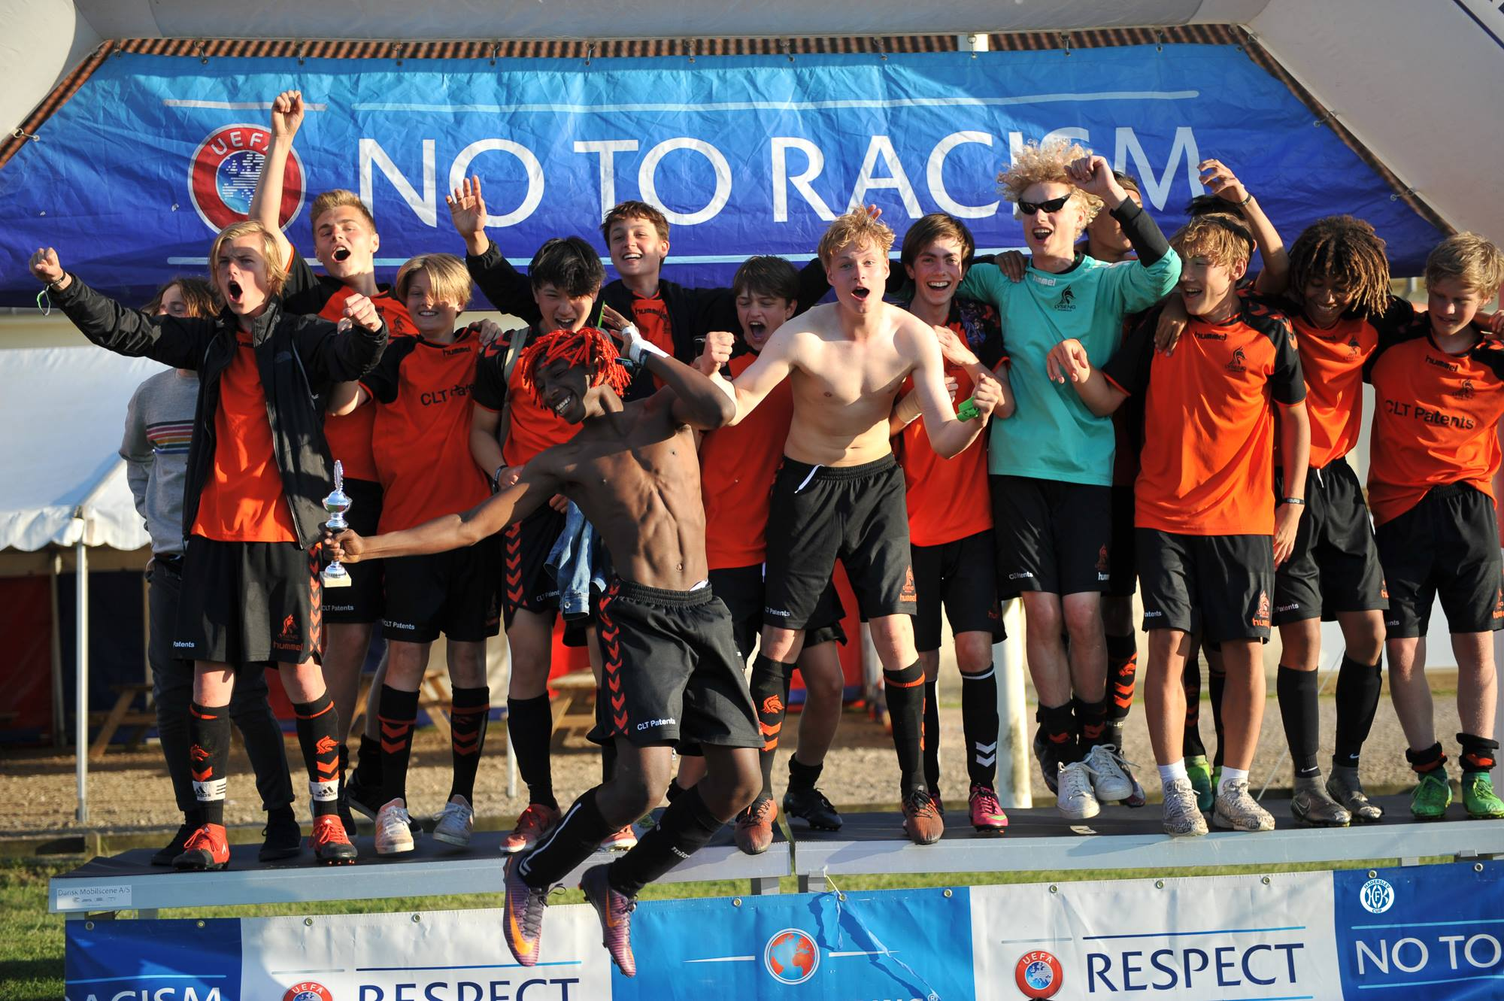

Sports Coach Qualification and Competencies
Idrættens Konsulenthus
Henrik H. Brandt
Tlf. +4529210972
henrik.brandt@idkon.dk
Workshop: Baltic Black Sea Economic Forum,
Sports and Economics,
Klaipéda, Lithuania, 26th October 2018

Slide 2
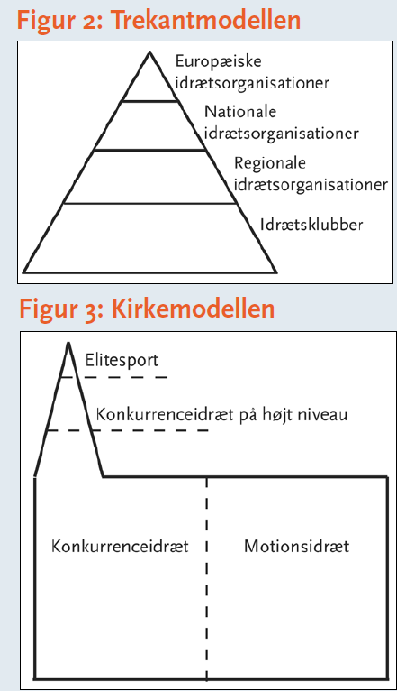
The future role of the sports coach has many aspects
- the biggest need is for coaches/instructors to take up new roles
Competitive Recreative
Organised Health
Sport Sport
Idrættens Konsulenthus
Henrik H. Brandt
Tlf. +4529210972
henrik.brandt@idkon.dk
EOSE definition of the sports and leisure sector

Slide 3
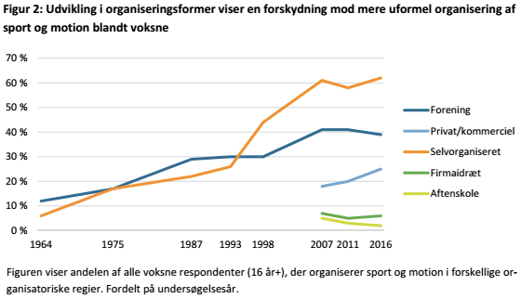
More sectors compete for people (and coaches)
Adults +16
Clubs
Commercial
Self org.
Company
Evening school
Idrættens Konsulenthus
Henrik H. Brandt
Tlf. +4529210972
henrik.brandt@idkon.dk
Danskernes motions- og sportsvaner 2016, Idrættens Analyseinstitut

Slide 4
The definition of a good coach depends on the task
What is the ideal coach?
Idrættens Konsulenthus
Henrik H. Brandt
Tlf. +4529210972
henrik.brandt@idkon.dk
Share of the Danish population +16 who regularly practice sport or exercise? Idrættens Analyseinstitut, 2016

Slide 5
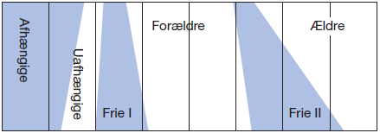
A good coach understands the life phases
(and education of coaches takes different approaches
Dependent Independent Free phase I Parents Free phase II Elderly
Idrættens Konsulenthus
Henrik H. Brandt
Tlf. +4529210972
henrik.brandt@idkon.dk
Danskernes motions- og sportsvaner 2011 (Idrættens Analyseinstitut) og Instituttet for fremtidsforskning

Slide 6
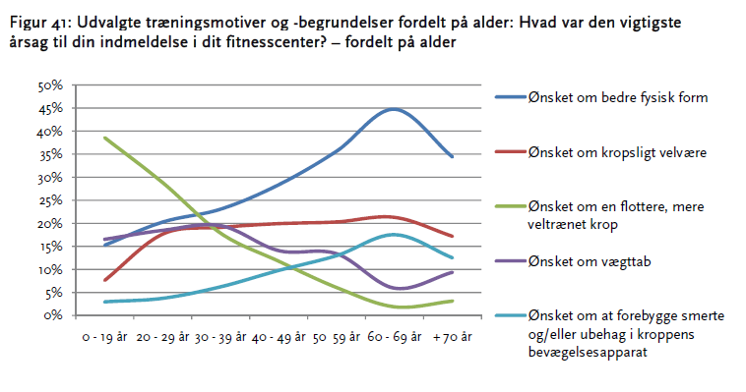
The coach must understand that motives vary a lot
Motives for going to the gym
Desire for better health
General wellbeing
Good looking, fit body
Weightloss
Preventing pain, rehabilitation
Idrættens Konsulenthus
Henrik H. Brandt
Tlf. +4529210972
henrik.brandt@idkon.dk
Fitnesskultur mellem forening og forretning - aktive fitnessudøveres træningsmotiver, tilfredshed og selvvurderede sundhed. Idrættens Analyseinstitut, 2010

Slide 7
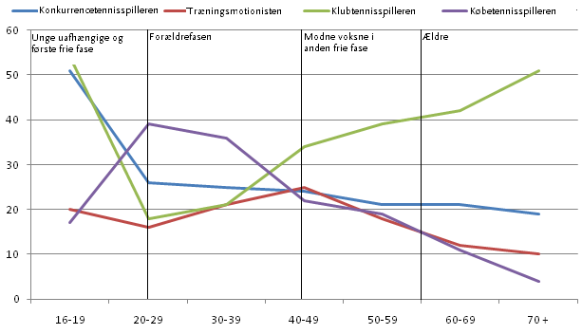
Which ‘arch types’ do you know from your sport?
– and do you have coaches/skills to cater for them all?
Tennis
Competitive player
Training player
Club player
Pay and play player
Tennis i Danmark – en medlemsundersøgelse i Dansk Tennisforbund. Idrættens Analyseinstitut 2010
Idrættens Konsulenthus
Henrik H. Brandt
Tlf. +4529210972
henrik.brandt@idkon.dk

Slide 8
Football in a club is peaking in the 6th class – at this stage we already laid the foundation for succes (or failure)
If more than 40 % of all boys and almost 20 % of all girls play football in a club in the 6th class.
What are we then doing ‘wrong’ since we know we are going to lose almost all of them in the next years?
What is the role and the responsibility of the coach in this?
No. of lost teams?
Idrættens Konsulenthus
Henrik H. Brandt
Tlf. +4529210972
henrik.brandt@idkon.dk
Kilde: Svar fra 32.853 skolebørn fordelt på 16 kommuner,
2014-2017. Idrættens Analyseinstitut/CISC

Slide 9
Which climate do we offer our kids – and what are the consequences (at a later stage)?
‘Restores’ justice.
Removes trust and readiness to learning
Tome consuming, expensive. Without continued reward the wanted behaviour dissapears.
Law, structures, culture
Often the role of the coach is based on this, which does not create trust and respect
The position of the coach as ‘the wisest’ is only for loan. In some areas kids are wiser than the coach. Use it.
The coach/leader must have an insight into his own mind and the mind of the player/athlete and hereby gain natural aothority. The coach must be a light house, just and fair and create an environment based on trust and understanding of the counterpart
Bases of power
Free adoption of French & Raven and the book ‘Mentalisering i familien’ , Hagelquist and Rasmussen
Punish-ment
What we teach the kids while they still obey us…
Reward
Legitimacy, social power
Knowledge/expert, we are wiser
Trust, responsible, calm, open,
Affiliaton, shared belief
Idrættens Konsulenthus
Henrik H. Brandt
Tlf. +4529210972
henrik.brandt@idkon.dk
Notes:
Straf: Den autoritære træner mister tillid/opbakning
Belønning: Ros med omtanke (ellers har det heller ingen værdi/effekt)
Lovgivning/struktur: utrolig meget kultur i en fodboldklub, pyramidetænkning/forskelsbehandling. Den dag, spillerne mister tilliden til den autoritet eller det ikke er det vigtigste for dem længere, går det galt
Viden: Kan man arbejde med mentorordninger, de ældre guider de yngre, Der sker en magtforskydning, hvor træneren ikke længere er den klogeste i alt, hvor spilelrne får egen viden/erfaring (og så mister man autoritet som fyrtårnet)’
Tillid til læring(Vidensbaseret læring): man skal forstå hvor man selv og modparten kommer fra, man skal gide at kende Louise. Man skal forstå, hvad der sker med Louise og kaj og deres forældre om ganske få år

Slide 10

Bedre fodboldmiljøer.
Mange frustrationer og fejltagelser (frafald) kunne måske undgås, hvis trænerne vidste mere om, hvad børn/unge reelt kan på forskellige udviklingsstadier?
The mental development of kids must be part of the toolbox
 | 4-8 år | 9-12 år | 13-18 år
Feelings | Svært at regulere, mangler perspektiv | Dialogue, can regulate feelings (and manipulate) | Complex and changing feelings and reflexions, further distance to parents and .authorities.
Physique | Fornemmelse af mestring. Tumler helt af sig selv | In control of/confident of the body, adolescence beginning. | Massive changes of the body, unsatisfied (maybe) with the body, sexuality
Behaviour | Optaget af regler | Wants to learn and reach a higher level (which can also cause negative experience). Ready to learn. Friends might begin to mean more than sport. | Compelx world gives escape to simplicity (computergames, realuíty shows), risk behaviour/quest for excitement.
Relations | Bevidst om hierarkier | Compares with others, conscious of appearence, friends are very important including fights for ‘position’. | Peers more important than adults, friends very important, parents are important one day, hopeless the next (but they must be there in the backgound).
Self | Oplever sig selv som kompetent, forældrenes rammer er vigtige (et fyrtårn) | Findes oneself competent, outer identity starts to mean more, friends/role models are getting more important, not just the parents. Sports-id might grow further or be replaced by other identities | Inner life hidden from adults, seeking identity, many lighthouses, need for thinking breaks.
Cognition, concentration | Én ting ad gangen, Tiltro til egne evner | More focused, ability to plan | Must maintain abilities, can act with complexity in some areas and be totally off target in other areas.
Idrættens Konsulenthus
Henrik H. Brandt
Tlf. +4529210972
henrik.brandt@idkon.dk
Mentalisering i familien. Hagelquist og Rasmussen, 2017
Notes:
Det korte af det lange
8-12. Vi har størst chance for at påvirke dem der, fordi de vil det, kommer ofte, er lydhøre… og motorisk kompetente etc.
De kan det hele, de begynde at blive mere bevidste
De begynder at få andre rollemodeller og få egen mening
Hvis vi opdrager dem skidt/ikke opdrager dem, får det konsekvenser senere
Vi skal også huske at opdrage forældrene mens vi har dem (teenagerne har meget mere brug for dem end man tror). Betyder også noget, om træneren har god forældrekontakt mht fastholdelse etc.
Vi kan begynde at lære dem nogle instinkter/værdier og ansvar, som så sidder på rygmarven, når de bliver teenagere.
Teeangere, meget optaget af de lidt ældre, kan det udnyttes? Mange andre fyrtårne end forældre
Nogle liv i sportshal etc… kan gøre noget der…

Slide 11
Reality is often different from the theory. Relative age effect
Does the best coach always win?
Distribution based on birth month in the Danish FA ‘Golden League’ for U11-U12 players (despite awareness of the relative age effect and efforts to counter the effects
Kilde: Et casestudie af Golden League med fokus på relativ alderseffekt i dansk børne- og ungdomsfodbold . Nicolai Noe og Rasmus Porse, Institut for idræt og ernæring, KU
Idrættens Konsulenthus
Henrik H. Brandt
Tlf. +4529210972
henrik.brandt@idkon.dk

Slide 12
OUTCOME
Pillar 5: excellence
Pillar 10: Elite sport Environment Media & Sponsoring
Elite sport
SPLISS
It is just not the same
as sport for
all. Maybe we
need SPLISS
for sport for
all environ-
Ments?
OUTPUT
Post career
INPUT
Pillar 9
Scientific research
Improved climate
Athletic career support
Pillar 8
(Inter)national competition
Pillar 4: performance
Pillar 7
Coaching provision & coach development
National governing bodies
Talent development
THROUGHPUT
Pillar 6
Training facilities
Talent identification system
Organized sport (clubs)
Pillar 3: initiation
Foundation & participation
INPUT
Non organised sport and physical education in schools
Pillar 1
Financial support
INPUT
Idrættens Konsulenthus
Henrik H. Brandt
Tlf. +4529210972
henrik.brandt@idkon.dk
Pillar 2
Organisation and structure of sport policies:
an integrated approach to policy development
De Bosscher et al., 2006

Slide 13
Is there such a thing as a ‘fourth team coach’ education?
Hvornår begynder elite forresten i en fodboldklub. Er der nogen, der kan definere det?
Skal vi arbejde med demotiverede spillere – eller lade dem gå og få et lettere og sjovere trænerliv?
Må man sige til dårlige spillere, at de måske skal droppe fodbold og lave noget andet?
Hvornår skal man ikke længere tage sociale hensyn i holdudtagelsen?
SPLISS Elements | ‘Førsteholdstræneren’ | ‘Breddetræneren’
Finances | We can always afford a bus and new shirts | A bus for away matches or new playing kits. Forget it.
Policies and structure | Development of good players is always the (unsaid) major goal of the club. The first team is the project of the club (and players) | Many clubs says ‘everybody welcome’ but in practice the distribution of pitches, equipment, recrutiment of coaches, allocation of time of the management etc. tells a different story. The third team is the project of the players
Recruitment base | Only the best. Always quality in the training – and the poorest ones are sent away. All players have an inner motivation… Be too late and you are out. | The poorest players might affect the quality and experience of the training. Motivation is varying. Some players will only play if they can play a fixed position. The coach has no sanction if he wants a team for the next match. Little interaction before/after training, substitution during a game makes the team poorer…
Talent development and talent-ID | I select only the best. I select my team the day before and they are ready + parents will drive to the match and support the team… Football is number one in the life of the players… | I need to think about friends and social relations when I select the team. If PK stops, JP will stop as well. I need to select 28 players fto assemble one full team, jobs/social pastures are more important than football. Football is not number one… How the f… do we get to the next away match…
Carreer support | Elite sport classes in school, parent support, physios, nutrition, pocket money, dad will drive… even four times a week. | ‘I forgot my football boots again’, Oh, he cannot play because he didn’t pay the membership fee, yet. Oh, he just didn’t show up for the match…Parents… we don’t know them…
Coach | License, courses, salary, prestige | Anybody… No pay, no qualifications. Pedagocial skills are at least as important as sporting skills. A young licensed coach would run away from this U17 third team immediately…
Competition environment | International tournaments, training culture, long season. I am a football player | Poor pitches, many cancellations, shorter season, no real training culture. I go to a football session… sometimes… No real challenges for the eager players (late bloomers)
Knowledge | Tactics, performance enhancement, set pieces, playing patterns, nutrition, physical training | F…, only 7 showed up today, last time we were 21. Oh, we only have a quarter of a pitch today and its getting dark early. Anybody who speaks Afghan? Are there public transportation to the next away match because no parents are driving?
Idrættens Konsulenthus
Henrik H. Brandt
Tlf. +4529210972
henrik.brandt@idkon.dk

Slide 14
Seeing the bigger picture through the local club…
Fra U13 og opefter er klubberne reelt i benhård konkurrence om spillerne med andre klubber og andre fritidsinteresser og den generelle livssituation.
Trænernes kompetencer er derfor afgørende for det ‘produkt’, man kan tilbyde.
Hold/årgang IF Lyseng | Antal medl. | Heraf fra 8270 Højbjerg | Heraf fra 8260 Viby J | Heraf fra 8000 Aarhus C | Heraf fra øvrige postnr. | Andel medl. fra 8270 i % | Andel medl. fra 8260 og 8270 i % | Andel medl. fra andre postnr. i % | Andel af beboerne i Holme og Skåde sogne i % **
Piger/kvinder
U6 Piger, 2013 | 6 | 6 | 0 | 0 | 0 | 100 | 100 | 0 | 5
U7 Piger, 2012 | 6 | 6 | 0 | 0 | 0 | 100 | 100 | 0 | 5
U8 Piger, 2011 | 21 | 20 | 1 | 0 | 0 | 95 | 100 | 0 | 15
U9 Piger, 2010 | 13 | 10 | 3 | 0 | 0 | 77 | 100 | 0 | 8
U10 Piger, 2009 | 20 | 18 | 1 | 0 | 1 | 90 | 95 | 5 | 14
U11 Piger, 2008 | 19 | 17 | 1 | 0 | 1 | 89 | 95 | 5 | 13
U12 Piger, 2007 | 26 | 22 | 2 | 0 | 2 | 85 | 92 | 8 | 17
U13 Piger, 2006 | 15 | 11 | 1 | 0 | 3 | 73 | 80 | 20 | 8
U14 Piger, 2005 | 20 | 12 | 3 | 0 | 5 | 60 | 75 | 25 | 9
U15 Piger, 2004 | 22 | 14 | 2 | 0 | 6 | 64 | 73 | 27 | 11
U16 Piger, 2003 | 24 | 14 | 0 | 1 | 9 | 58 | 58 | 42 | 11
U18 Piger, 2002 og 2001 | 23 | 6 | 3 | 1 | 13 | 26 | 39 | 61 | 2
Senior, kvinder | 59 | 13 | 9 | 18 | 19 | 22 | 37 | 63
Fodboldfitness | 13 | 11 | 2 | 0 | 0 | 85 | 100 | 0
Drenge/mænd
U6 Drenge, 2013 | 23 | 15 | 6 | 0 | 2 | 65 | 91 | 9 | 12
U7 Drenge, 2012 | 45 | 40 | 4 | 0 | 1 | 89 | 98 | 2 | 31
U8 Drenge, 2011 | 54 | 42 | 6 | 0 | 6 | 78 | 89 | 11 | 32
U9 Drenge, 2010 | 41 | 31 | 7 | 1 | 2 | 76 | 93 | 7 | 24
U10 Drenge, 2009 | 48 | 41 | 3 | 1 | 3 | 85 | 92 | 8 | 32
U11 Drenge, 2008 | 60 | 46 | 10 | 0 | 4 | 77 | 93 | 7 | 35
U12 Drenge, 2007 | 52 | 33 | 13 | 2 | 4 | 63 | 88 | 12 | 25
U13 Drenge, 2006 | 41 | 28 | 10 | 2 | 1 | 68 | 93 | 7 | 22
U14 Drenge, 2005 | 57 | 34 | 9 | 3 | 11 | 60 | 75 | 25 | 26
U15 Drenge, 2004 | 78 | 41 | 16 | 10 | 11 | 53 | 73 | 27 | 32
U16 Drenge, 2003 | 58 | 35 | 11 | 1 | 11 | 60 | 79 | 21 | 27
U17 Drenge, 2002* | 77 | 32 | 13 | 6 | 26 | 42 | 58 | 42 | 25
U19 Drenge | 50 | 17 | 3 | 3 | 27 | 34 | 40 | 60 | 7
Senior mænd | 102 | 31 | 6 | 39 | 26 | 30 | 36 | 64
Old boys | 92 | 55 | 1 | 8 | 28 | 60 | 61 | 39
FC Prostata | 23 | 1 | 4 | 1 | 17 | 4 | 22 | 78
Fritid | 6 | 0 | 0 | 0 | 6 | 0 | 0 | 100
I alt | 1194 | 702 | 150 | 97 | 245 | 59 | 71 | 29
*Heraf 19 på efterskolekontinent (hvoraf 16 fra 8270)
Idrættens Konsulenthus
Henrik H. Brandt
Tlf. +4529210972
henrik.brandt@idkon.dk

Slide 15
IF Lyseng boys 2002 – a succes story hiding many failures…
April 2014, U12: 63 players (4 not from ‘8270’)
April 2015, U13: 88 players
April 2016, U14, ca 105 players (6 league teams)
April 2017, U15, ca. 105 players
April 2018, U16, ca. 90 players (5 league teams)
August 2018, U17, 61 + 16 players (16 in bording school), Only 42 pct. from 8270, (4 league teams)
August 2014 (73 players, U13), only 11 left! (one in the first team+ one AGF U17Liga, prof), 10 in bording schools
Today we are still 77 players in U 17 but only because other local clubs were doing even worse and lost the whole teams…
(IF Lyseng football has the 4th largest youth department 13-18 years in Denmark)
Today it is too late to educate the players… All the internal fights for time slots, subsidies, equipment, ‘first team’ logics, respect, parents backing etc. that we didn’t get right when the kids were 10 years are now coming back to haunt us.
Idrættens Konsulenthus
Henrik H. Brandt
Tlf. +4529210972
henrik.brandt@idkon.dk
Notes:
Reelt stor udskiftning
Tiltrækker spillere fra hele byen
Godt træningsmiljø på førsteholdet, men vi kæmper på andet-fjerdeholdet (fremmøde, engagement, kommunikation, forældreopbakning)
Udfordring med kvalitet i træning, banekvalitet
Godt sportsligt niveau
Mange bestræbelser på fastholdelse/kommunikation med spilelrne, men fodbold er ikke nummer ét længere (vi forsøm,te at skabe værdier og opdragelse, da de var U11-U12-spillere, og vi døjer stadig med motivation7rester af den store forskelsbehandlin fra dengang.
Min styrke: kendte kurverne, baggrund som løber, kommunikation/organisering af trænere/kampe etc.
Min bagdel: manglende tid til det træningsmæssige
Spillerne kommer fra: AGF, Viby, Aros, ASA, TMG, BMI, Aabyhøj, TST, VSK, Skanderborg, Hørning

Slide 16
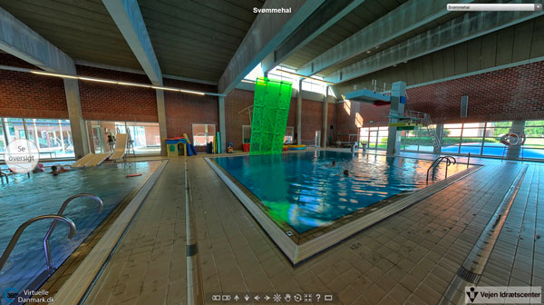
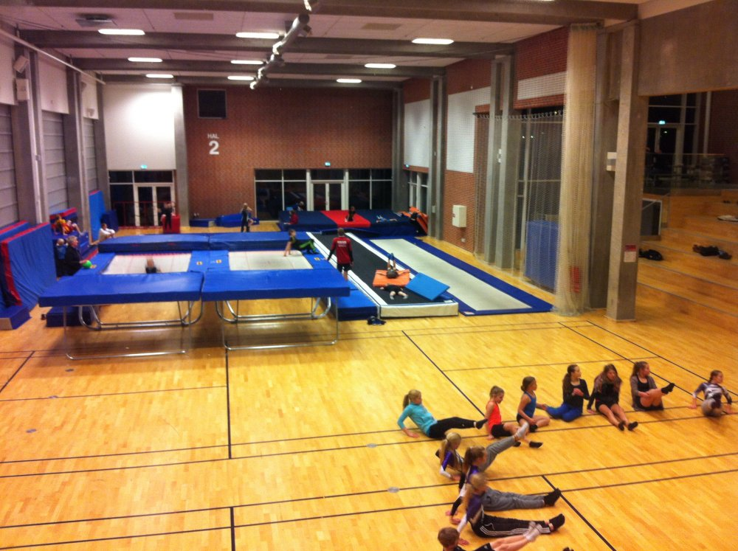
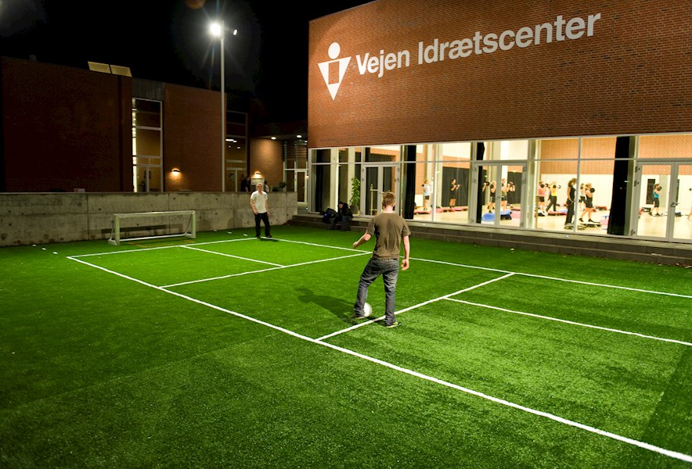
Summary: What does the mental aspect and various levels of the kids mean for coaching qualifications?
If we base our coaching only on our authority…
If we base our coaching and approach on the ‘sporting pyramid’ from a young age…
(which is the general rule in most sports…)
We lose a lot of talent because of the relative age effect (some ‘talents’ fade out, other ‘talents’ never god selected to the good ‘school’, some late bloomers never get the chance…
We lose an awful lot of teenagers because they get other priorities, and our authority and (contact to the parents) disappears (because we did it the wrong way when they were smaller kids and we ‘had them’ in our hands)
Solution: We must create good and engaging training/social environments for everybody – not just focus on talent selection/development from an early age…
Idrættens Konsulenthus
Henrik H. Brandt
Tlf. +4529210972
henrik.brandt@idkon.dk
Vejen Idrætscenter, DK

Slide 17
What about coaches for adults and the inactives?
To have fun
Need someone to go with
Don’t bother
Has a break
A large part of my social life
To be with friends
To challenge my body
Poor health
Spending time on work/family
Idrættens Konsulenthus
Henrik H. Brandt
Tlf. +4529210972
henrik.brandt@idkon.dk
Figures from a Danish municipality, Idrættens Analyseinstitut

Slide 18
Can clubs get them back in? What does it mean for coaching?
Creat ‘serious’ offers for the ‘unserious’ – (perhaps cross age groups and gender)
Make it more flexible/informal for the adults
Make alternative offerings for kids and youth who is not attracted by traditional tournament structures and competition (but still wants progress…)
Adapt the programmes to the seniors (e.g. during daytime)
Idrættens Konsulenthus
Henrik H. Brandt
Tlf. +4529210972
henrik.brandt@idkon.dk
Kilde: Fremtidens idrætsfaciliteter i Ringsted Kommune

Slide 19
Can coaches assist in overcoming barreers?
Interest
Idrættens Konsulenthus
Henrik H. Brandt
Tlf. +4529210972
henrik.brandt@idkon.dk
Danskernes motions- og sportsvaner 2011, Idrættens Analyseinstitut

Slide 20
Sports providers must deliver on many values/motives
Helt uenig
Helt enig
Idrættens Konsulenthus
Henrik H. Brandt
Tlf. +4529210972
henrik.brandt@idkon.dk
Developed by Maja Pilgaard, Idan, based on 2011 Danish Sports Participation Survey

Slide 21
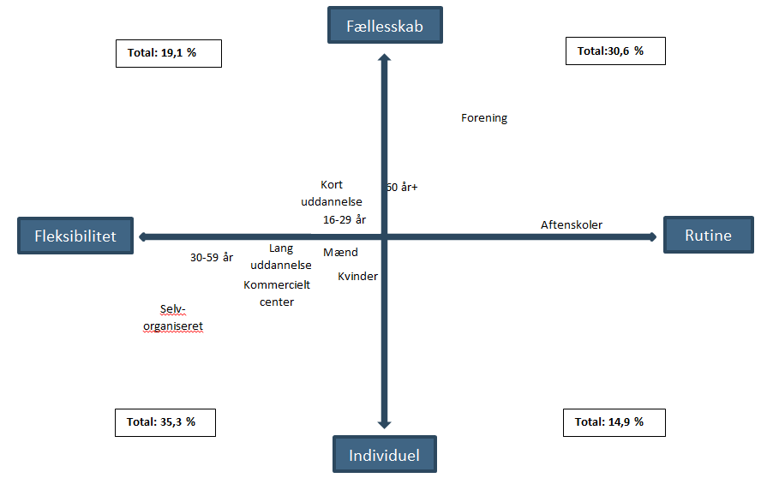
A grid of the various roles of coaches/instructors
Community
Facilities as provider
‘Our parks’ programmes?
Light communities (Endomondo, NBRO,
Power leagues/facilitating etc.
FLEXIBILITY/ACCESS
Develop sporting skills (club sport)
Local community driven
Focus on local needs and target groups?
Social, healthy, engaging
INNOVATION IN ACTIVITIES AND IN CLUB GOVERNANCE/FOCUS
Flexibæe
Routine
Events - a busy market place
Outdoor options/ski
Tests and optimisation
RECREATIONAL SPORT
Personal training
Health related training, advice, support, safe environment
HEALTH SPORT
Idrættens Konsulenthus
Henrik H. Brandt
Tlf. +4529210972
henrik.brandt@idkon.dk
Individual

Slide 22
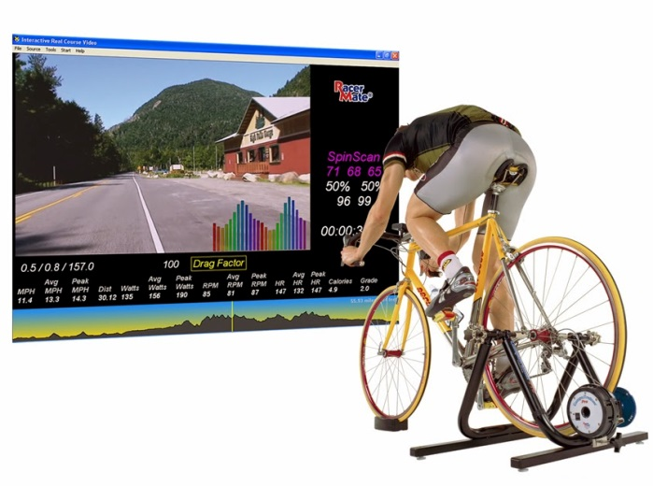
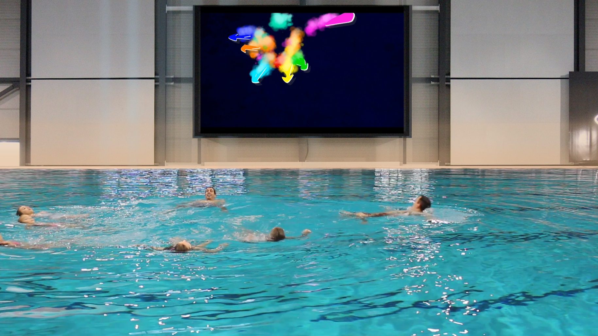
Trend 1: Entrepreneurship, exergaming
Idrættens Konsulenthus
Henrik H. Brandt
Tlf. +4529210972
henrik.brandt@idkon.dk
inspiration: athliit.com, barbrothers.dk, outdoorconcept.dk, dansketrailløbere, trailbuilders osv. osv.

Slide 23
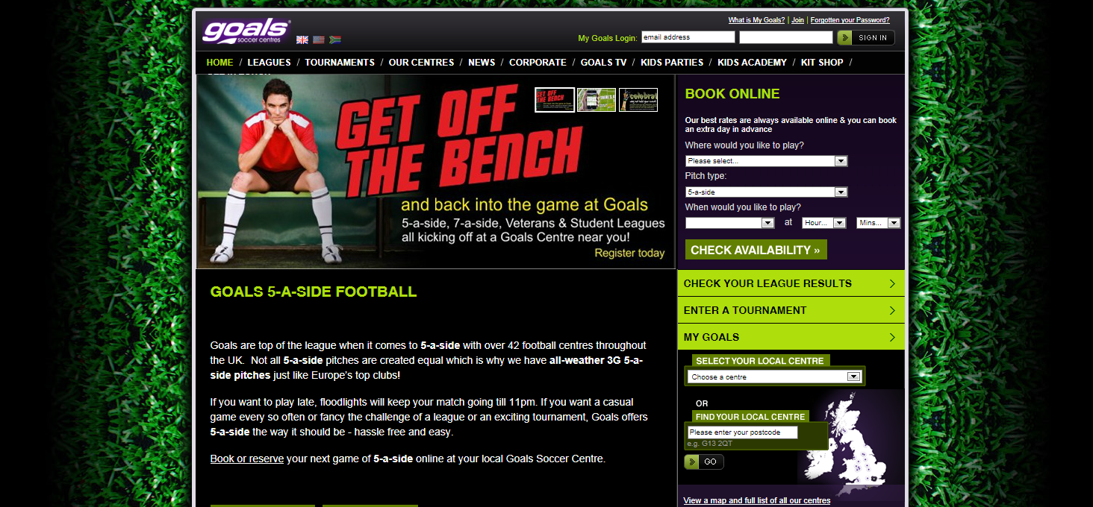
Trend 2: Flexible team sport. Who runs mass football of the future?
Idrættens Konsulenthus
Henrik H. Brandt
Tlf. +4529210972
henrik.brandt@idkon.dk

Slide 24
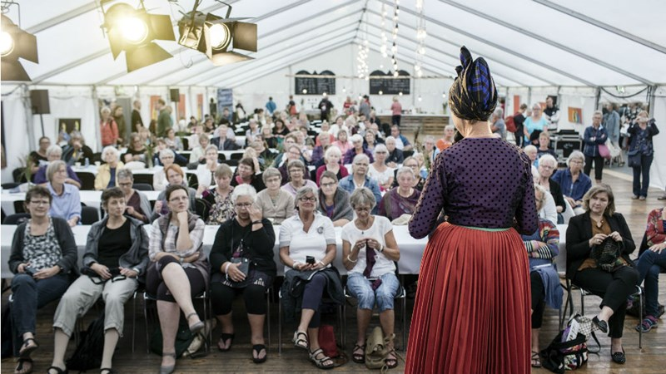
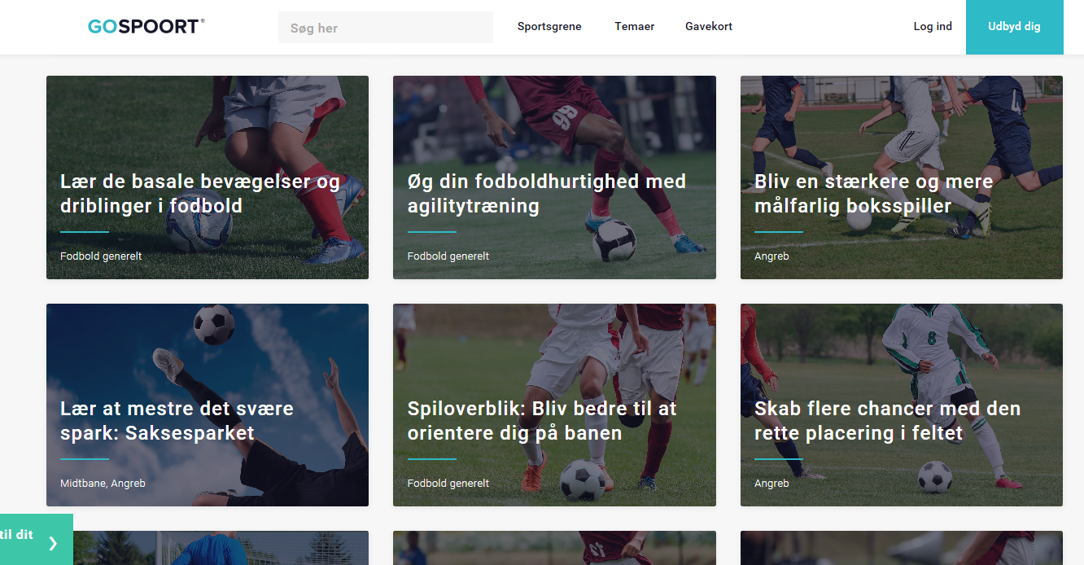
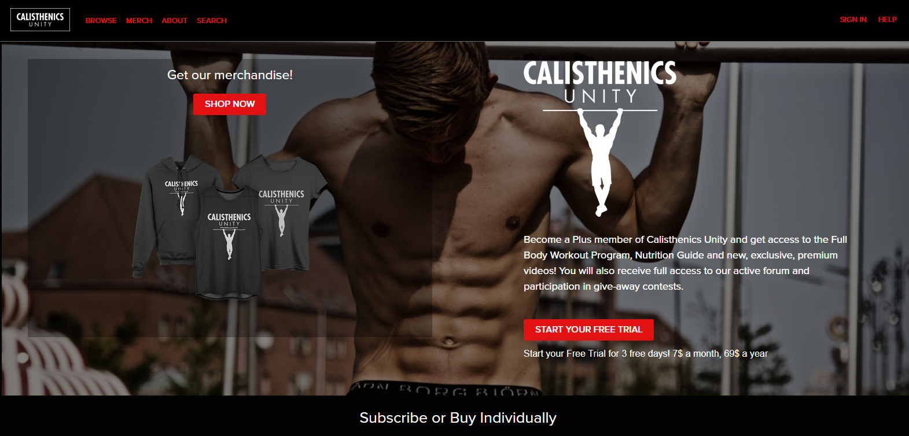
Trend 3: Some coaches are rock stars. Direct to consumer
Idrættens Konsulenthus
Henrik H. Brandt
Tlf. +4529210972
henrik.brandt@idkon.dk
inspiration: athliit.com, barbrothers.dk, outdoorconcept.dk, dansketrailløbere, trailbuilders, Calisthenics Unity osv. osv.

Slide 25
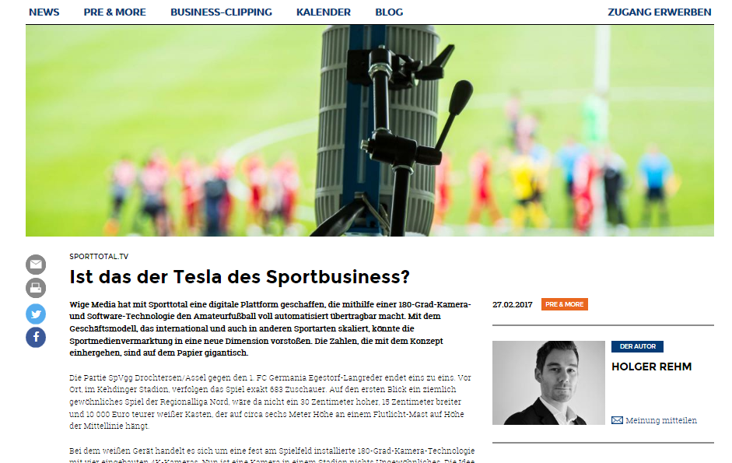
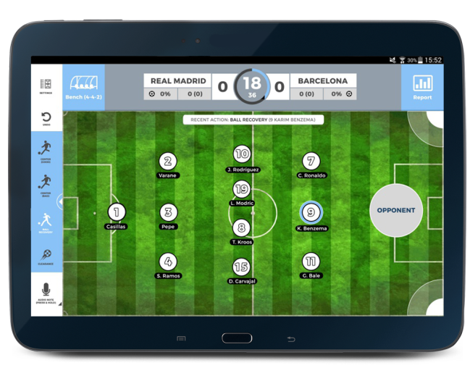
Trend 4: What will technology mean for the role of coaches?
Idrættens Konsulenthus
Henrik H. Brandt
Tlf. +4529210972
henrik.brandt@idkon.dk
Kilde: Sponsors.de
180 graders kamera, software, high lights, personlig vinkel

Slide 26
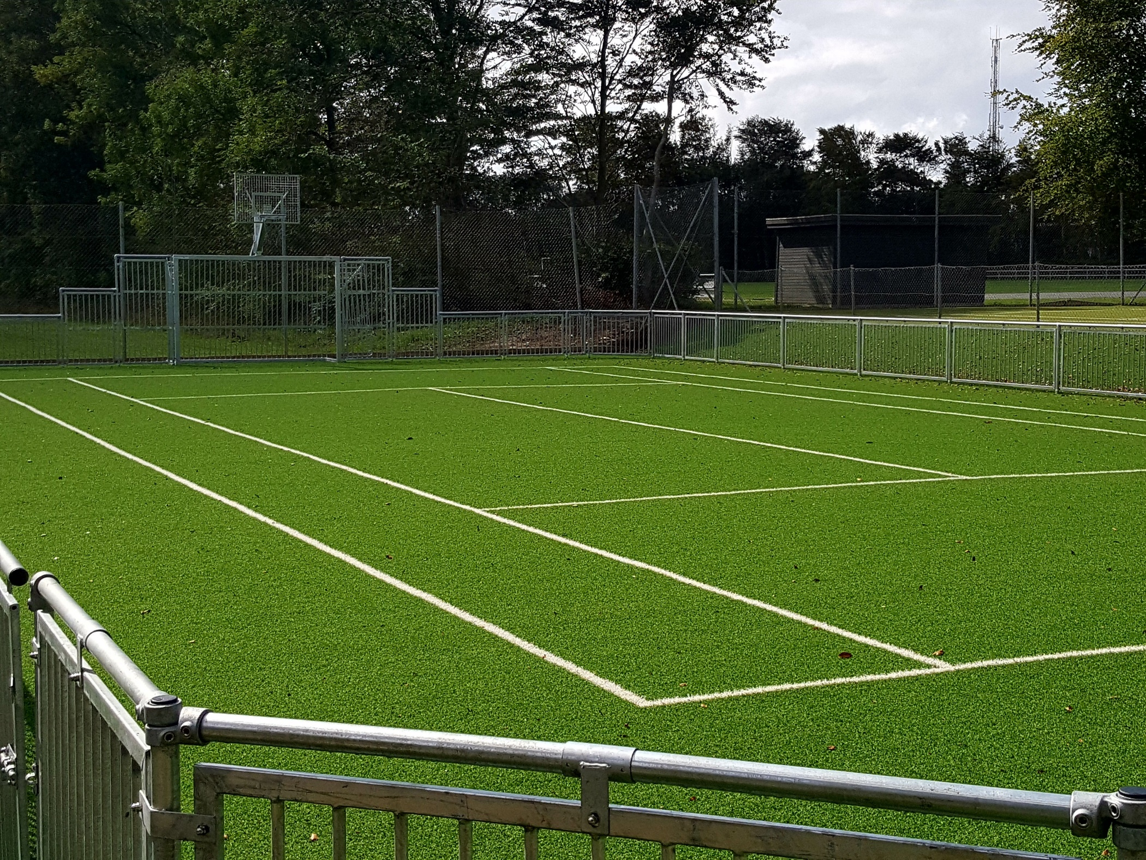
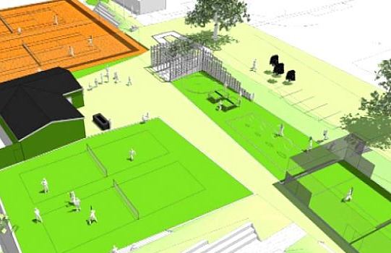
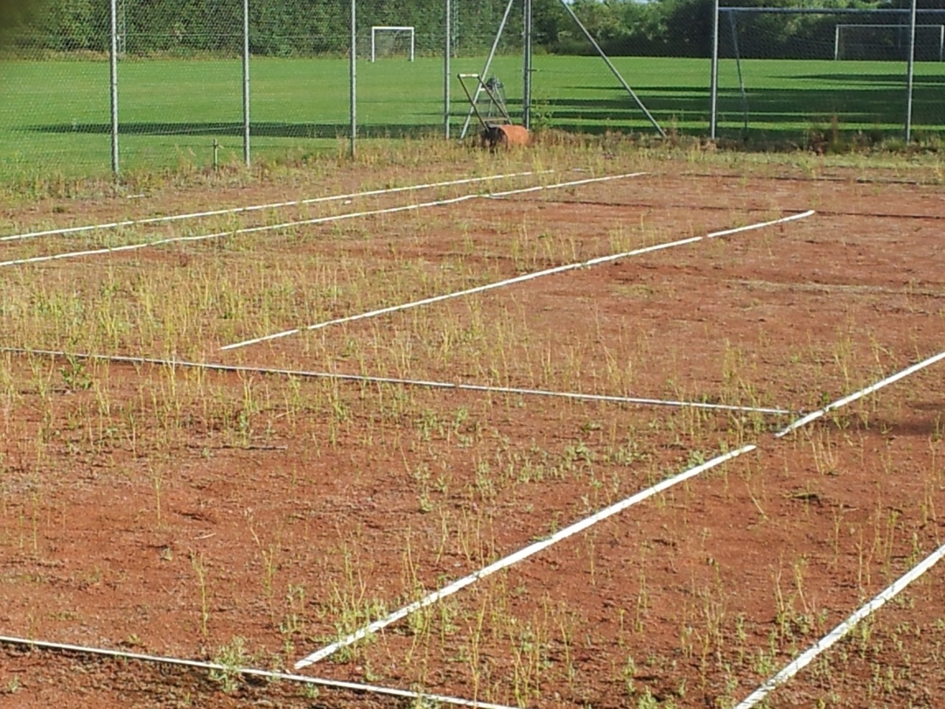
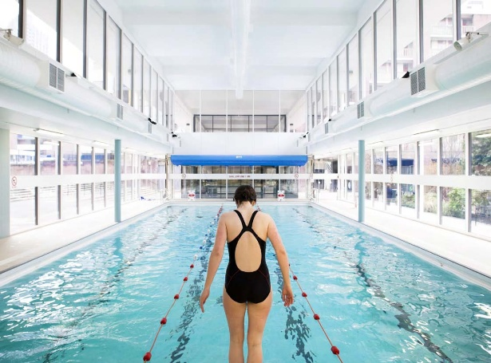
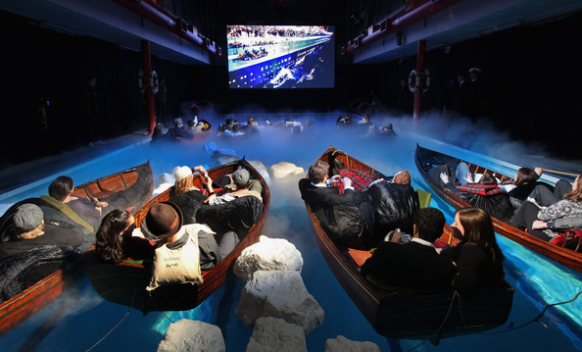
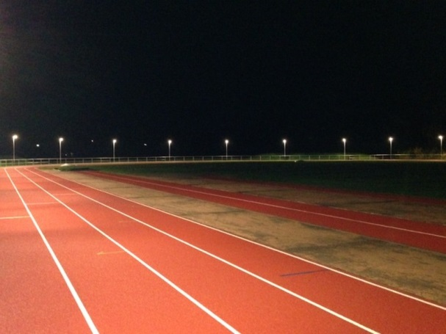
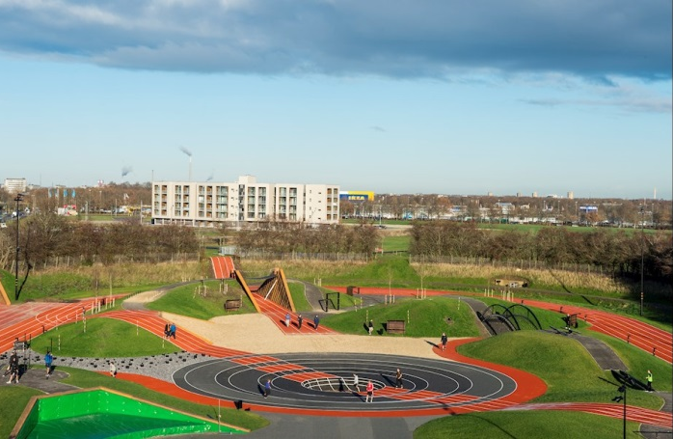
Trend 5. Facilities. Who can sweat the asset?
Idrættens Konsulenthus
Henrik H. Brandt
Tlf. +4529210972
henrik.brandt@idkon.dk

Slide 27




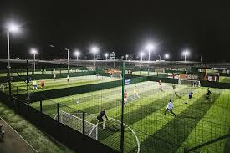
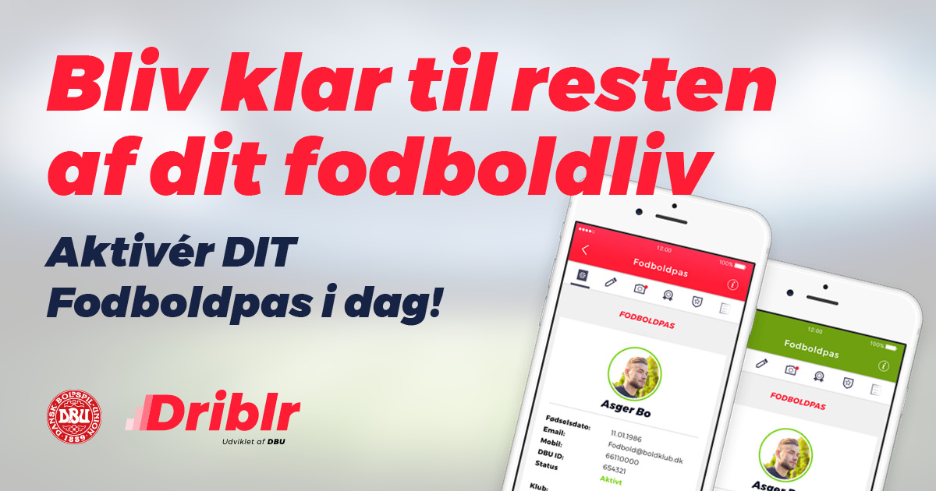
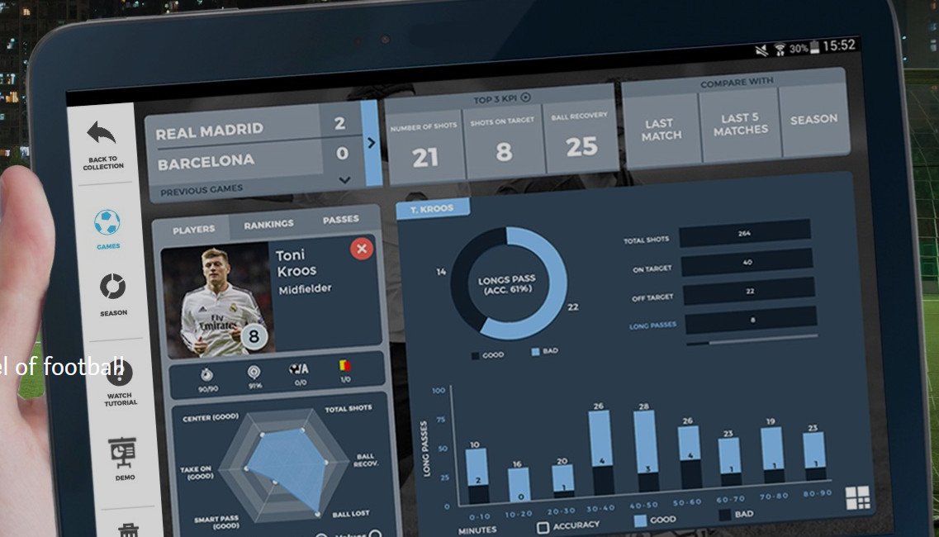
Communication skills are very important (and difficult)
Should be part of coach qualifications…
Idrættens Konsulenthus
Henrik H. Brandt
Tlf. +4529210972
henrik.brandt@idkon.dk
Notes:
Facebookgruppen
Stats
Get level up
Holdsport (DBU-beslutninger)
Hvad gør Goals?
Hvad gør gymnastik?
Hvordan deler vi erfaringer mellem trænere?

Slide 28
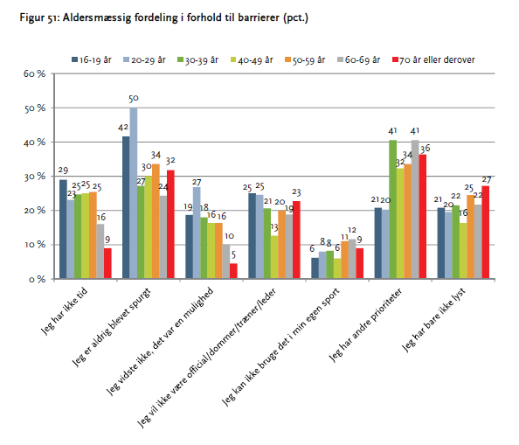
Education. How do we create the right workforce of coaches?
Important factors:
Marketing
Willingness to learn take courses after age, role, own leven, experience etc.
Club environment and tradition
Priorities of clubs, authorities, and organisations
Practical organisation of courses depending on age, ambitions etc. of the participants
Content and objectives of the courses
The three largest reasons for not taking courses among young coaches: Never asked!, no time, didn’t know it was an option…
Idrættens Konsulenthus
Henrik H. Brandt
Tlf. +4529210972
henrik.brandt@idkon.dk
Idrættens uddannelses- og kursusbehov set fra medlemmernes perspektiv. Idrættens Analyseinstitut 2011

Slide 29
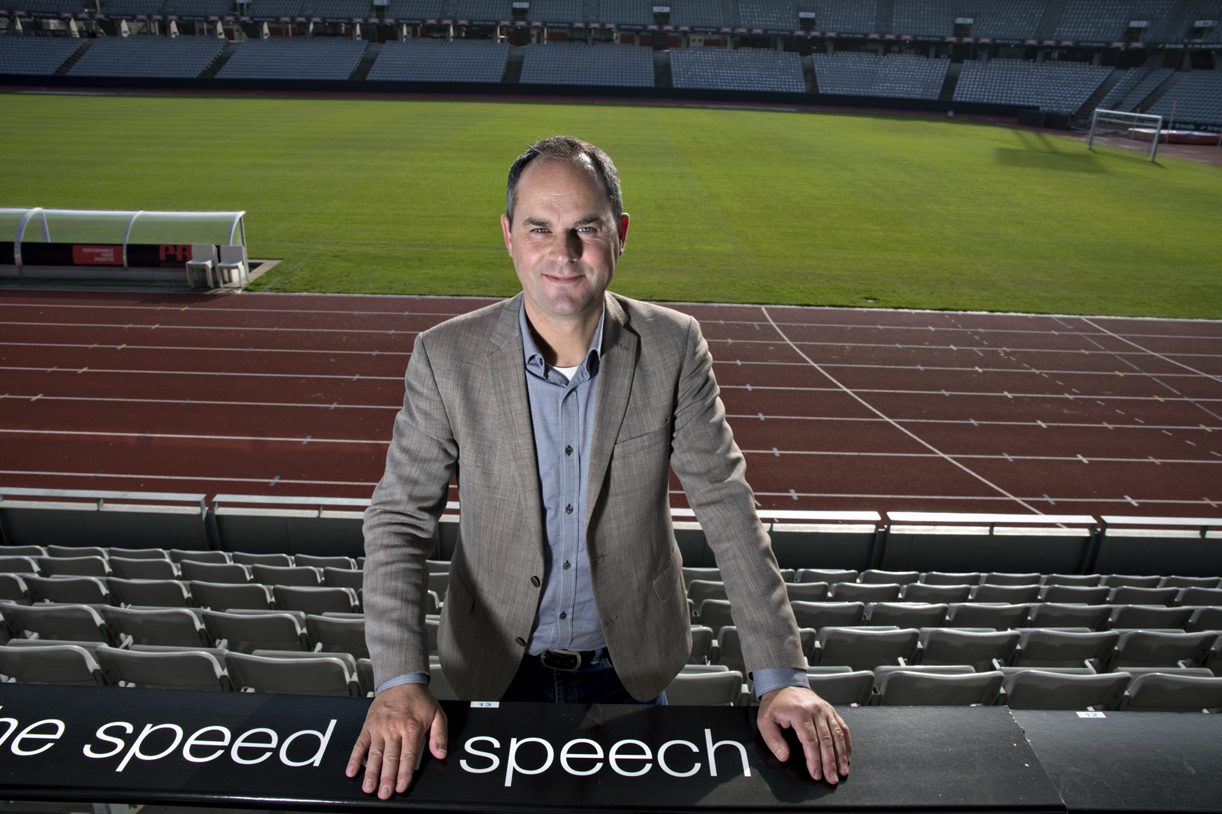
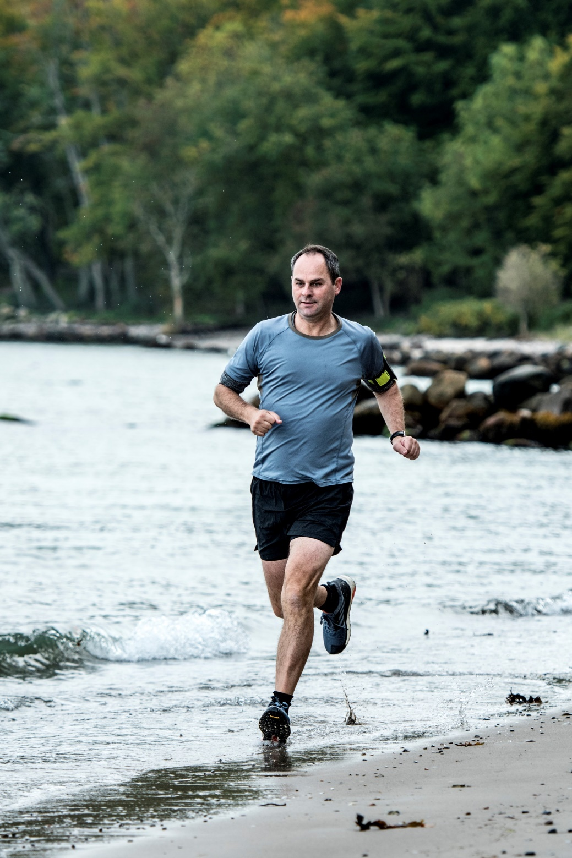
Thank you for the attention. And good luck with your coaching!
Idrættens Konsulenthus
Henrik H. Brandt
Tlf. +4529210972
henrik.brandt@idkon.dk
Workshop: Baltic Black Sea Economic Forum, Sports and Economics,
Klaipéda, Lithuania, 26th October 2018

