Slide 1
Employment and Skills in
Sport and Physical Activity
Stephen Studd
EOSE, Director of Development

Slide 2
INTRODUCING EOSE
Independent not for profit organisation (France, 2002)
EU membership and network (20 Countries)
Knowledge and expertise in the sport and physical activity sector, labour market and VET policy
Small central team - support and management
Specialisation:
  Sport and Physical Activity sector
  Sport Education Systems
  Workforce development
  Linking education to the labour market
  European policies and initiatives
Recognised as expert/adviser by EC

Slide 3
EOSE VISION FOR THE SECTOR
Sport fulfilling its potential as a social and economic driver
Better sport and healthy lifestyles for all
Improved service to meet the specific needs of every client
Delivered through better skilled people
Fit for purpose qualifications and training (cooperation)
Reflecting employment needs based on updated and consistent labour market information
Clear employment and career structure and pathways
Sport fully integrated into NQF and EQF – qualifications delivered nationally based on common standards
Transparency, transferability, mobility
Volunteering and informal learning valued and recognised

Slide 4
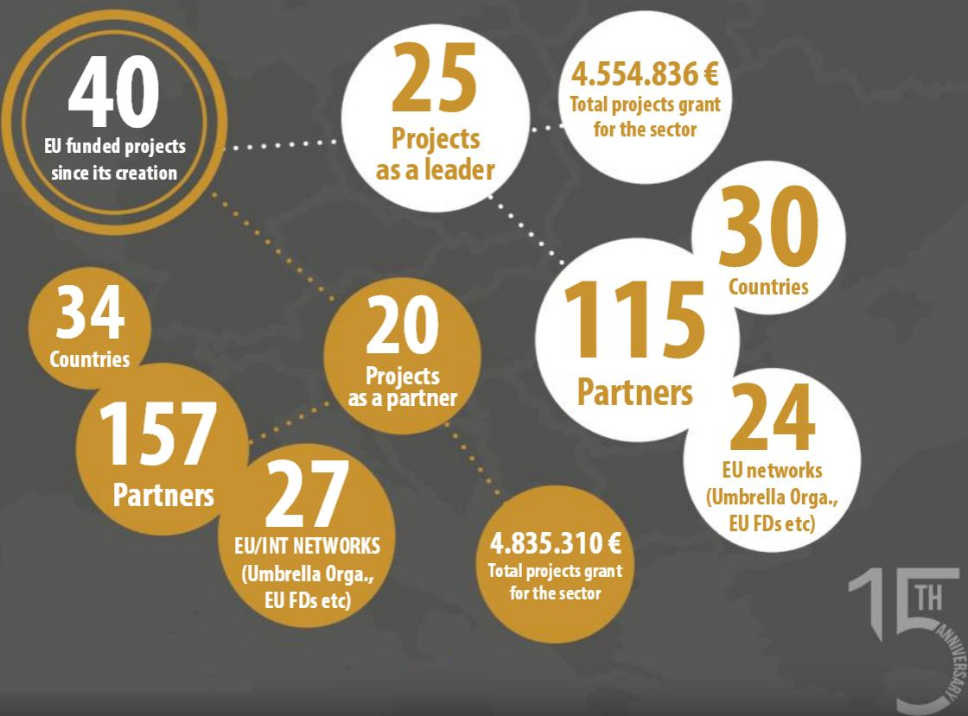
INVOLVEMENT WITH EU PROJECTS

Slide 5
Introducing:
The EUROPEAN SECTOR SKILLS ALLIANCE
(ESSA-Sport)

Slide 6
THE OPPORTUNITY
Erasmus+ Key Action 2 – Sector Skills Alliances
500,000 Euros maximum over 2/3 years
SSAs aim at:
Tackling skills gaps by identifying sector specific labour market needs and new skills in one or more occupation
Strengthening exchange of knowledge between education and labour market
Modernising VET, integrating work-based learning, exploiting potential to drive economic growth and innovation
Building trust, cross-border certification, professional mobility, qualification recognition

Slide 7
SPECIFIC AIMS
1
3
5
UNDERTAKE DESK RESEARCH (N/EU) (labour markets, sport systems, education/qual. systems)
ENSURE WIDE CONSULTATION AT NATIONAL AND EU LEVEL (Bottom-up approach)
IDENTIFY PRIORITIES FOR ACTION AT NATIONAL AND EU LEVEL
2
4
6
CONDUCT EU ONLINE EMPLOYERS SURVEY ON SKILLS NEEDS
DEFINE AND UNDERSTAND THE SECTOR (Realities, skills needs, tendencies etc)
ESTABLISH SUSTAINABLE NETWORK OF STAKEHOLDERS AND WORK PLAN
Notes:
© Copyright Showeet.com
7

Slide 8
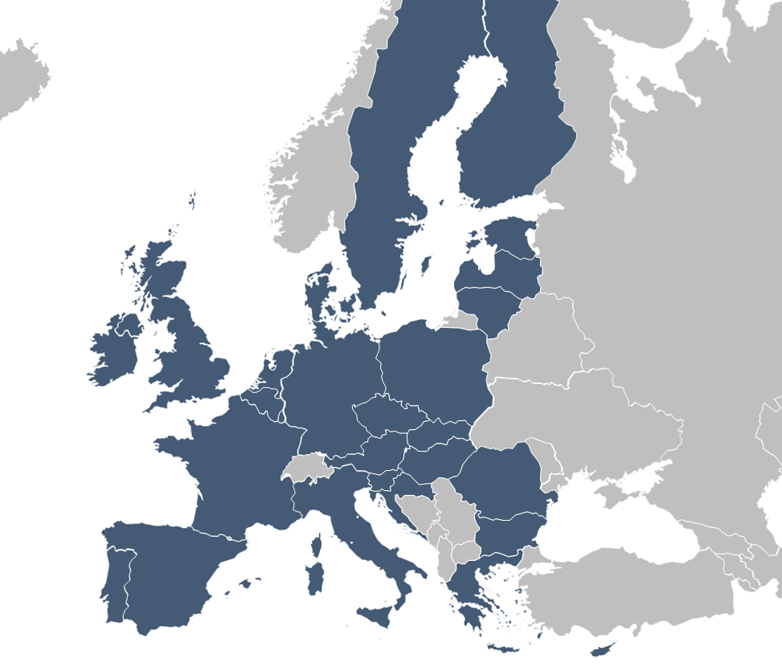

SCOPE – EUROPEAN UNION
OFFICIAL PARTNERS OF ESSA-SPORT = 20 COUNTRIES
COUNTRIES WITHOUT OFFICIAL PARTNER = 8 COUNTRIES

Slide 9

Outputs
From this process to produce:
  National Reports (20 + 8) – research, consultation, validation
  the first Employment Map of the sport sector across the EU based on the National Reports (bottom up approach)
  the first Skills Profile (Map) of the sector’s current and future skills needs across the EU
  a sustainable network of sector stakeholders (Sector Skills Partnerships) at national and EU level to lead action to address the skills priorities identified in the reports
  and to establish a EU Strategic Action Plan with concrete recommendations and priorities
  To inform the EU tools – the EU Skills Panorama and ESCO

Slide 10
Why is the ESSA Important?
We all believe in the power of sport and physical activity to change lives
It has huge potential to create jobs, to generate economic activity, to improve health, to engage communities and support social cohesion
Yet it is hugely fragmented – by nation, by sport, by sub-sector, public sector from private sector etc
We are failing to engage the whole community – too few are active, the disadvantaged and those with disabilities are under-represented
Success depends on a skilled workforce – managers, instructors, coaches etc – working together to deliver opportunities for activity for all
We are a people focussed industry
Can ESSA provide a focus for collaboration and change?

Slide 11
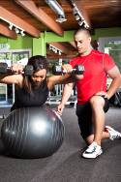
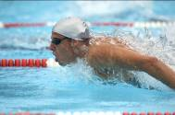



SCOPE – Sport & Physical Activity
"ALL FORMS OF PHYSICAL ACTIVITY WHICH, THROUGH CASUAL OR ORGANISED PARTICIPATION, AIM AT EXPRESSING OR IMPROVING PHYSICAL FITNESS AND MENTAL WELL-BEING, FORMING SOCIAL RELATIONSHIPS OR OBTAINING RESULTS IN COMPETITION AT ALL LEVELS."

Slide 12
SCOPE - NACE CODES
93 Sports activities and amusement and recreation activities
93.1 Sports activities
93.11 Operation of sports facilities
93.12 Activities of sport clubs
93.13 Fitness facilities
93.19 Other sports activities
85.51 Sports and recreation education*
*This class includes the provision of instruction in athletic activities to groups of individuals, such as by camps and schools. Overnight and day sports instruction camps are also included. It does not include academic schools, colleges and universities. Instruction may be provided in diverse settings, such as the unit’s or client’s training facilities, educational institutions or by other means. Instruction provided in this class is formally organised. This class includes:- sports instruction camps, sports instruction, gymnastics instruction, riding instruction, academies or schools, swimming instruction, professional sports instructors, teachers, coaches, martial arts instruction, card game instruction (such as bridge), yoga instruction.

Slide 13
Warning
Statistics in this presentation have been produced in dialogue with Eurostat (bespoke analysis)
Being tested with national co-ordinators
  and discussed with NSOs and other sector data
Labour Force survey – consistent methodology BUT
  sample size
  NSO data - different sources, employer data v labour force interview
  different levels of detail, and samples

Slide 14
Employment in sport organisations
Sport Organisations – NACE code 93.1
Total Employees – 1,295,293
Including:
476,020 Sport Occupations (37%)
  ISCO code 342 including:
  Athletes and players
  Coaches, Instructors and Officials
  Fitness and Recreation Instructors
819,273 Sport related Occupations
  (114,967 Managers)

Slide 15
Sport Organisations Characteristics:
57% full time
84% employed
15% self employed
Age – 15-24: 25%
Age – 25-49: 53%
Age – 50+: 22%
43% female
Education - Graduates+ 32%
Education - Medium: 50%
Low Education – 18%

Slide 16
Sport Organisations
Largest employing countries:
UK (26%)
Germany (13%)
Spain (10%)
France (9%)
Italy (9%)
49% in top 3 countries

Slide 17
Sport Occupations -
Sport delivered Other Sectors
Sport specific occupations (ISCO code 342)
  Athletes and players
  Coaches, Instructors, Officials
  Fitness and Recreation Instructors
In Sport Organisations – 476,020 (52%)
In other Sectors – 432,117 (48%)
Total Employment in Sport
  Sport Organisations – 1,295,293 (all employees)
  + Sport Occupations outside sport – 432,117
TOTAL – 1,727,410 employees delivering sport

Slide 18
Other Sectors using Sport
Total Sport Occupations – 908,137
Sport Occupations outside sport - 432,117
Sport Education (85.5) -175,670
Other Education – 50,710
Public/community sector - 45,675
Health/Social care – 29,840
Accommodation/Hotels - 15,718
Agriculture/water – 13,062
Membership Orgs – 10,040
But is this still an underestimate?

Slide 19
Sport Occupations
Full time 52%
57% male
Self employed 32% (15% in sport orgs)
58% age 25-49
Education: Medium – 46%
Education: High - 42% (32%)
Athletes: 53,474*
Coaches: 351,038*
Fitness & Recreation Instructors: 249,007*
  * Based on 20 countries

Slide 20
Employment in Baltic States
        NACE 93.1 Sport Occs 342 TOTAL
Lithuania 6.067 3.659 7.229
Latvia 1.963 2.885 4.572
Estonia 4.538 2.763 4.735
Sport Occupation Characteristics - Lithuania
81% employed status (EU 67% - 32% self-employed)
59% male (EU 57%)
88% full time (EU 52%) 75% in sport organisations
78% high level education (EU 41%)
26% (age over 50) (EU 18%)
10% under 25 (EU 24%)

Slide 21
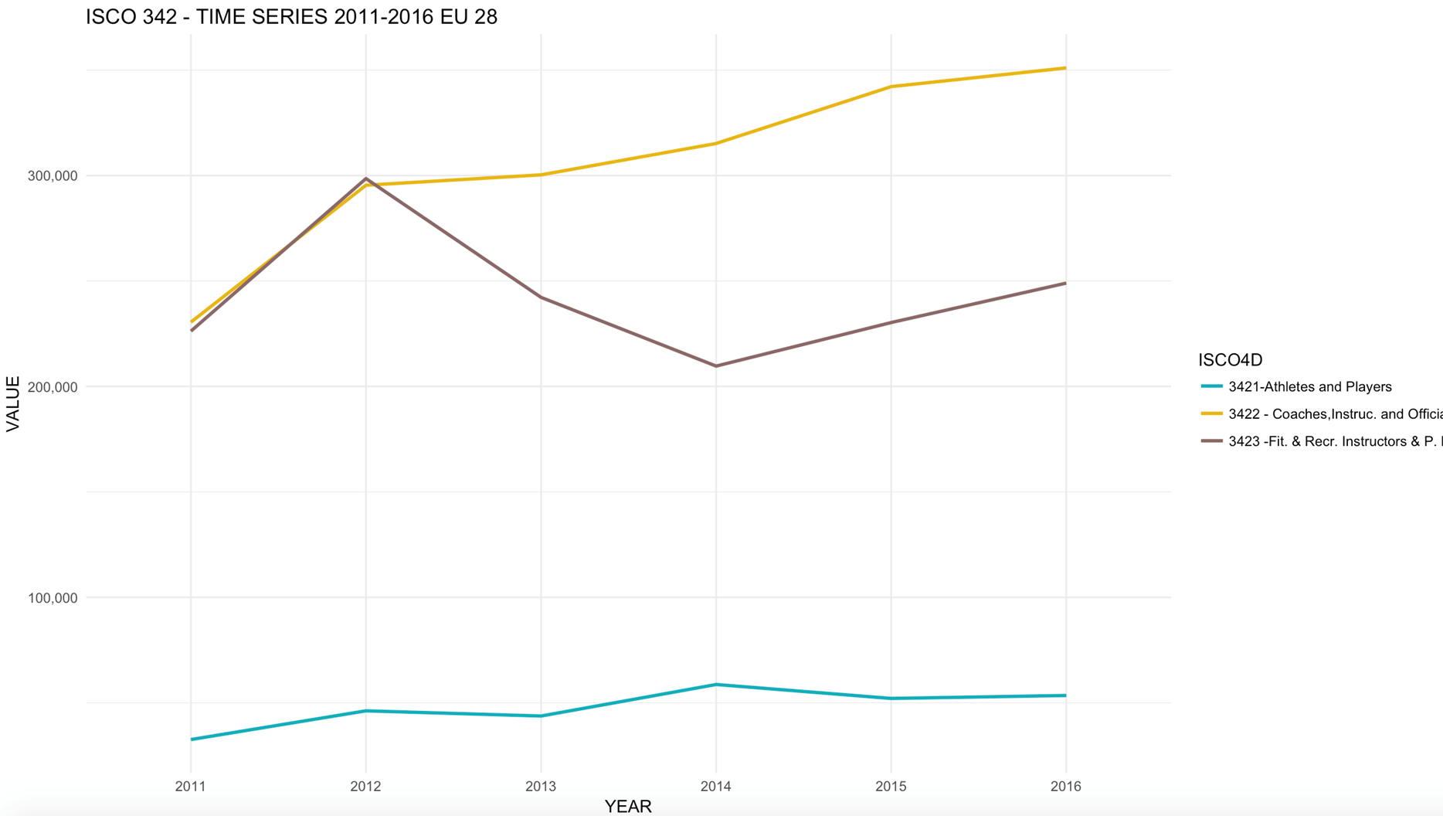

Slide 22

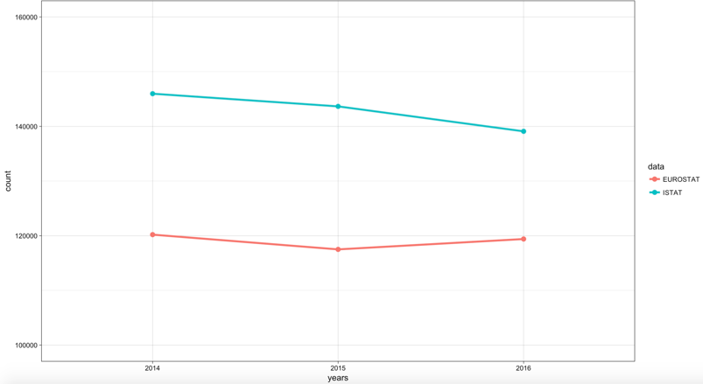
Italy Case Study – missing jobs?
Employment in sport, Italy, EUROSTAT/ISTAT data comparison

Slide 23
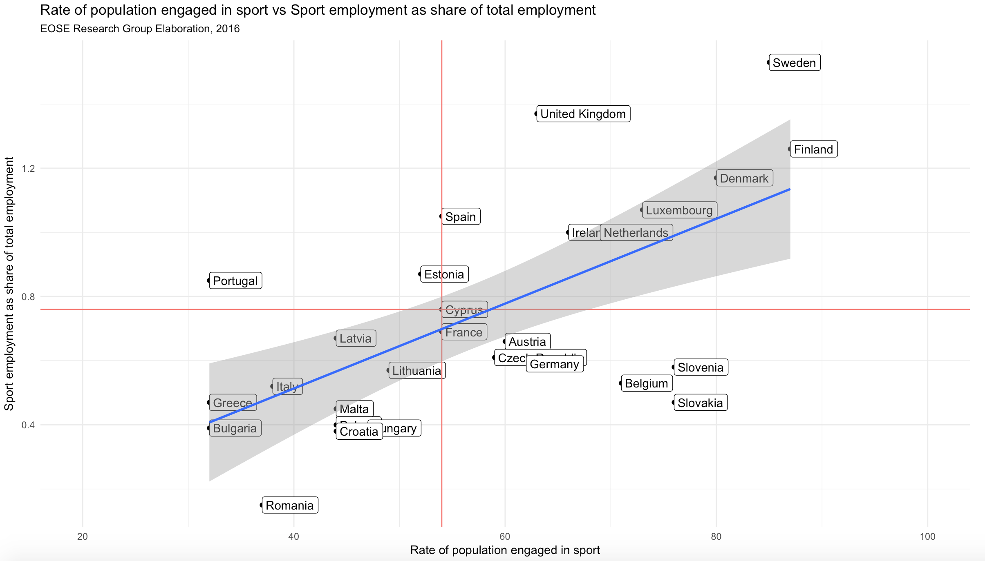

Slide 24
Understanding Change and Skill Issues
The Sector is changing and we need to understand it.
New organisations offering sport and physical activity
Changing and complex employment characteristics – part-time, self-employed, second jobs, seasonality
High expectations from many Governments in terms of qualifications
Conflicting regulation – sport system v Government regulation
Sport’s role is changing – health, tourism, social cohesion, personal development, employability, new jobs - new skills and training needed
Not just a numbers game! - Occupational data important

Slide 25
Issues from Consultation
Feedback from Round Table Events in 10 countries
FOR DISCUSSION

Slide 26
Feedback - National Round Tables
A growing sector in a Europe that is changing and being challenged - e.g migrants/refugees/youth unemployment
Changing roles/expectations from Governments of Municipalities and Federations
Austerity and public spending cuts – Municipalities and grants to sport
Yet - pressure to increase levels of physical activity, improve health, attract the hard to reach people, encourage social integration
A people facing sector where a skilled and qualified workforce, is paramount to its success.
A sector driven by volunteers in Europe: 35 million Volunteers in Sport (= 7% population EU)
Challenges in delivery, challenges from Government, challenges in skills

Slide 27
CHALLENGES for FEDERATIONS
To achieve international success
To maintain integrity of their sport (doping, match fixing)
To sustain and grow their clubs
To improve and update governance at all levels
To improve gender equality (leaders, coaching, participants)
To become inclusive (including those with disabilities)
To bring qualifications inside formal system (NQF/EQF)
To link international federation requirements with national systems

Slide 28
CHALLENGES – PRIVATE SECTOR
To integrate the growing private sector and new entrepreneurs into the established “system”
Regulate or not? – a challenge to established structures in the Sector
Concern of regulators - quality/health and safety?
Validity of training and qualifications
Lack of structure and organisation
Big potential in fitness, in activity tourism
Emergence of small businesses and growth of international chains

Slide 29
REALITIES AND CHALLENGES
Potential often underestimated or not recognised but expectations are growing
Employers seeking well trained employees but existing courses not regarded as sufficiently relevant – there is a recognised gap between competences required and learning outcomes acquired
Sport training often outside national qualification structure
VET very limited in the sector in many countries
How clear is the Sector career structure and pathways?
Which course? Which job? – key questions for young people: do we have the answer?
Increased desire of mobility – how transferable are skills and qualifications?

Slide 30
Next Steps - please get involved
CONSULTATION phase
National Stakeholder Groups
On-line EU questionnaire (all languages)
Focus – recruitment and skill needs of your organisation
www.essa-sport.eu
Spring 2019 – National stakeholder consultation
  Sport System
  Education and training supply
  Labour Market
  Skills priorities – from survey results
GO ON LINE TODAY!

Slide 31

IMPACT and NEW EXPECTATIONS
EDUCATION
EMPLOYABILITY
ECONOMY
HEALTH
SOCIETY

