Slide 1
Sports' Contribution to Economics and Employment
Introduction to Research Results of 2018
25 October 2018

Slide 2
Introduction
EU is strongly involved into sports. Treaty on the Functioning of the European Union: “The Union shall contribute to the promotion of European sporting issues”.
Working Group “Sport and Economics” set up in 2006 by DG EAC:
  elaborated the Vilnius Definition of Sport,
  launched national Sport Satellite Accounts (SSAs) to foster evidence based policy making.

Slide 3
The First Study
The first pan-EU SSA was published in 2012 based on 2005 data.
First-time calculation of economic impact of sport on EU’s economy:
  Gross Value Added (GVA): 1.76%
  Employment: 2.12%
The order of magnitude was unexpectedly high.

Slide 4
The Need for an Update
Croatia joined the EU in 2013.
The economic crisis may have altered some fundamental relations.
The Vilnius Definition of sport had to be revised.
The base year (2005) was long ago.
Therefore, an update was necessary: “Study on the Economic Impact of Sport through Sport Satellite Accounts” for 2012 data.

Slide 5
National IOTs
Multiregional Input-Output Table for Sport
(MR-IOT:S): used calculate direct and indirect effects of sport industry.
Eight SSAs were already available:
AT, CY, DE, LT, NL, PL, PT, and UK.
Substantial data were available for:
BG, ES, FR, LU, and SK.
SSAs of other countries were approximated.

Slide 6
Additional Data
Foreign trade data from UN-comtrade and OECD data-bases.
Allow identification of sport-related foreign trade.
Eurostat provided substantial data on sport-related employment.
Other EU-wide data bases (Eurydice report) and institutions.

Slide 7
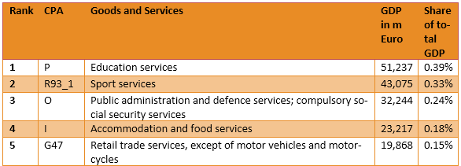
GDP
Sport related GDP was found to be 279.7 bn Euro.
This equals 2.12% of total GDP.
Thus, around every 47th Euro is generated by the sport sector.

Slide 8
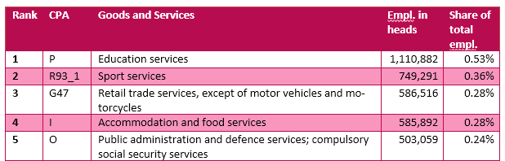
Employment
Sport-related employment: 5.67 m persons.
That equals 2.72% of total employment.
Every 37th employed person works in sport sector.

Slide 9
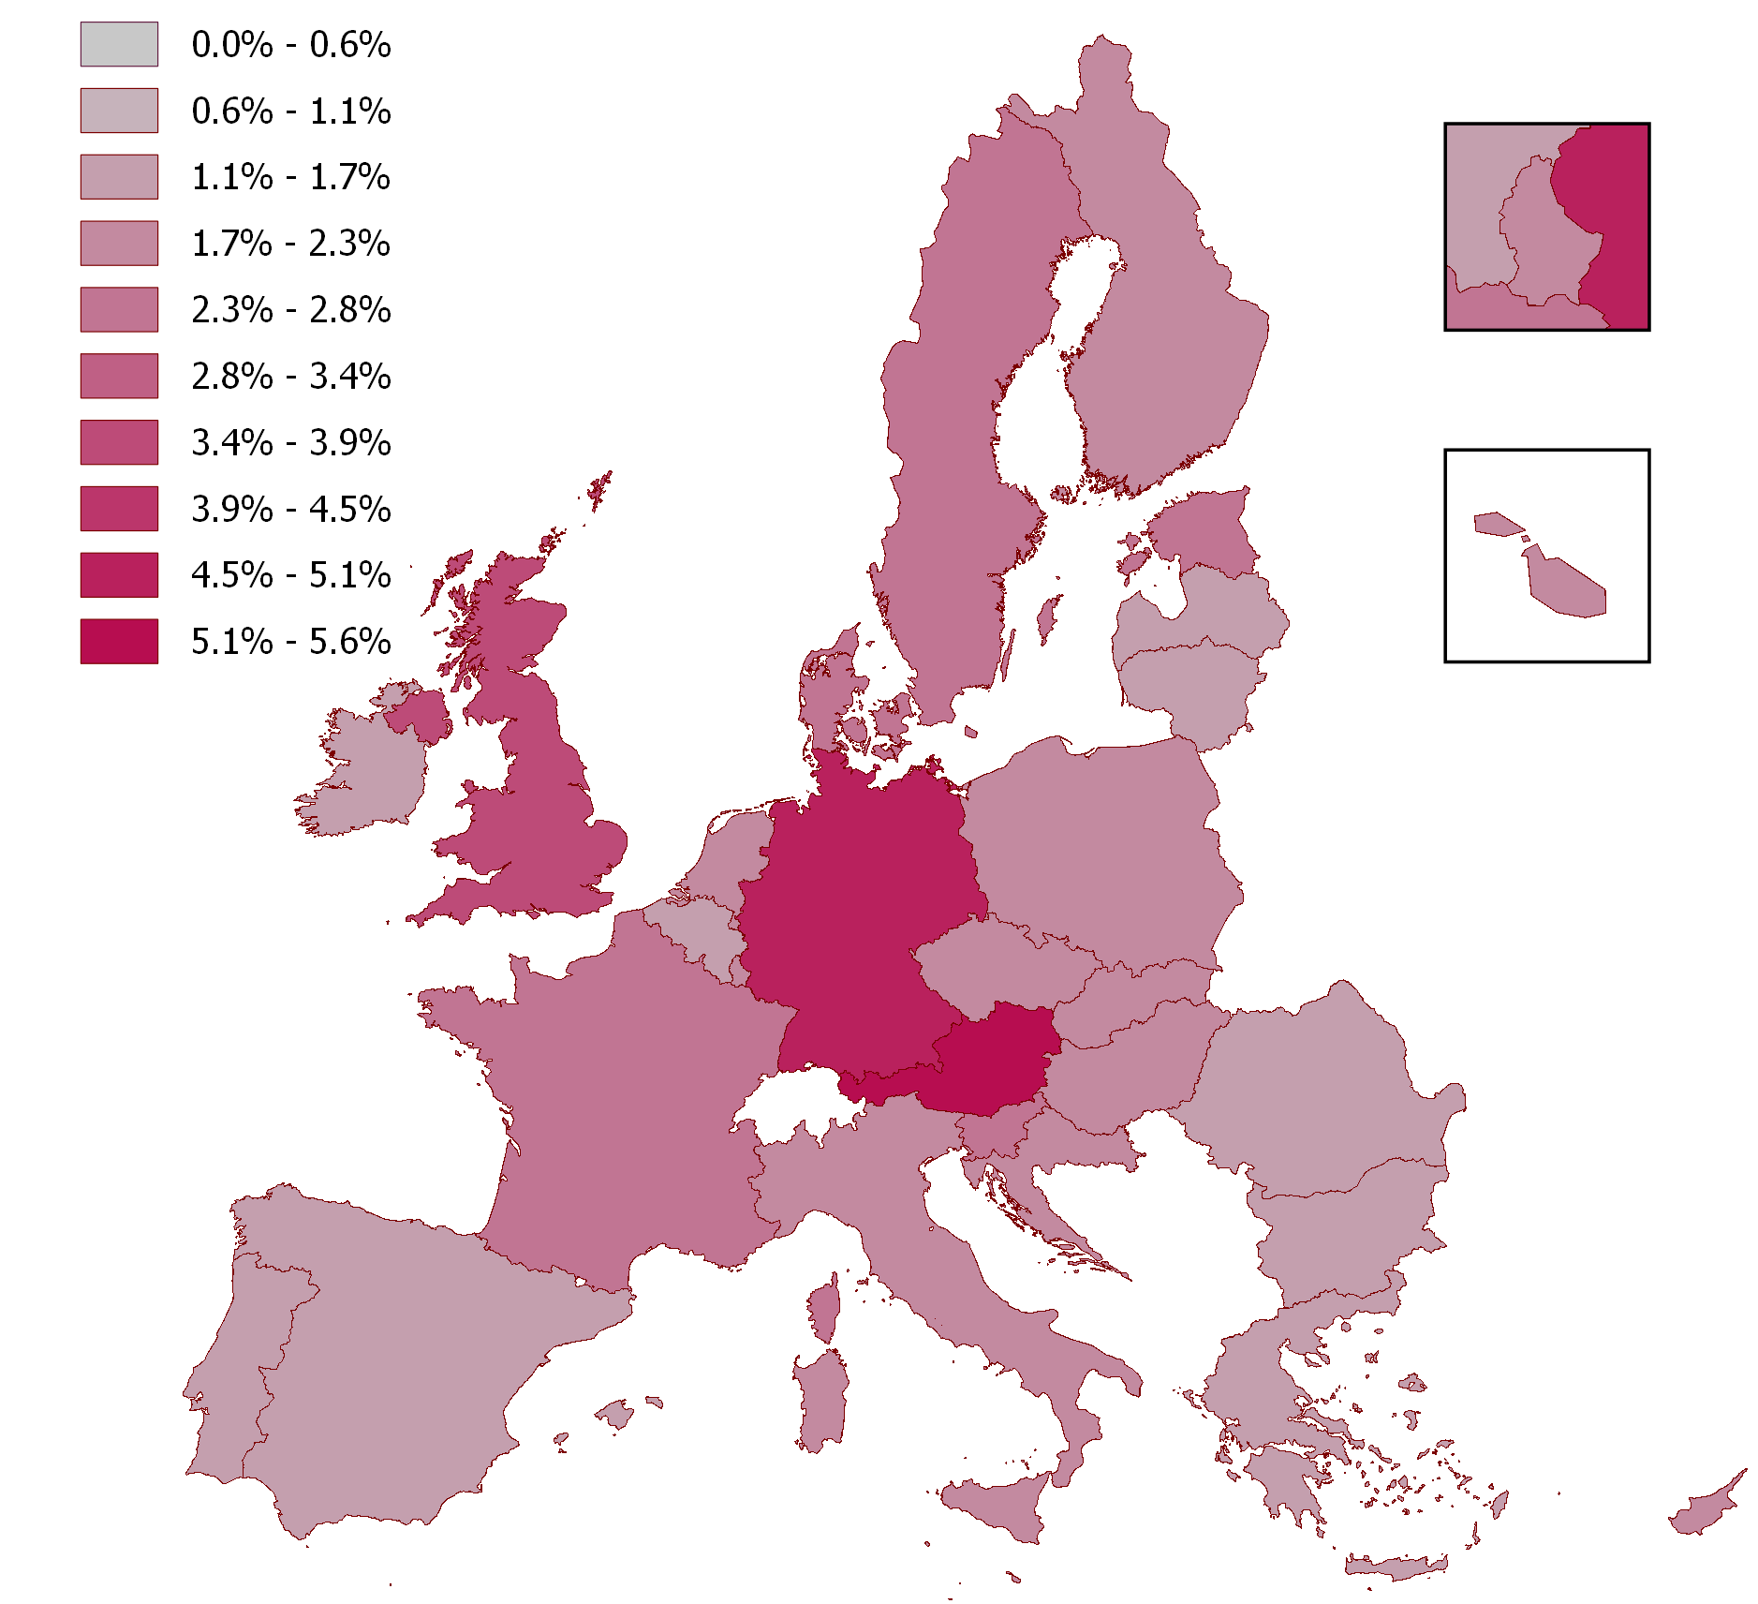
Employment on a Glance

Slide 10
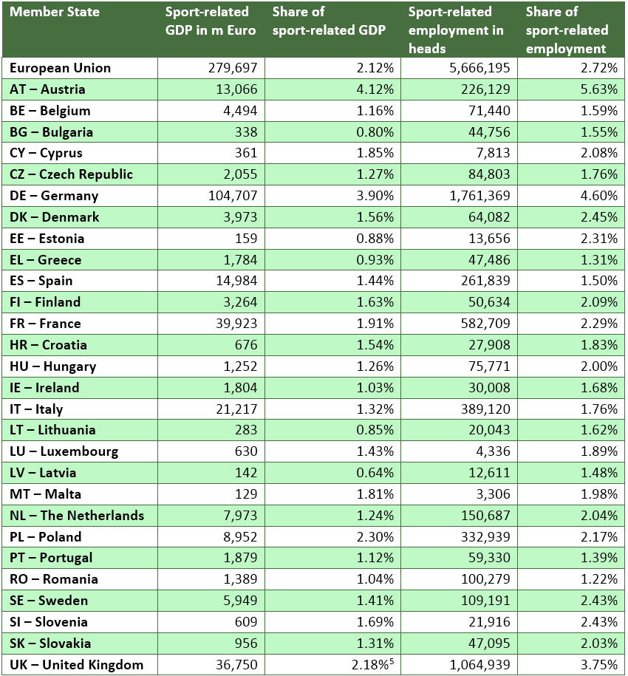
Member States

Slide 11
Multipliers
Every company needs intermediate goods (IMGs) from other companies.
IMG distribute economic effects from sport companies (direct) to all companies (total).
Multiplier = total effect / direct effect
Highest multipliers for food and beverages (2.55), followed by motor vehicles (2.50) and repair- and installation services (2.32).

Slide 12
Broad, Total Effects
Direct effects in sport-related companies:
  GDP equals 279.7 bn Euro or 2.12%,
  Employment: 5.67 m persons or 2.72%.
Total effects including supply networks:
  GDP equals 483.8 bn Euro or 3.67%,
  Employment equals 8.46 m persons or 4.06%.

Slide 13
Core and Narrow Definition
Core definition (Sport services):
  43.1 bn Euro or 0.33% of GDP,
  749.000 employment or 0.36%.
Narrow definition (everything you need for sport):
  178.0 bn Euro or 1.35% of GDP
  3.75 m employment or 1.80%.
(all direct effects only)

Slide 14
Lessons learned
Sport is a large sector. Direct employment is similar to the number of Denmark‘s inhabitants.
Sport is employment intensive. It generates more employment per GDP than an average sector.
Sport economy is different in every Member State.
IOTs for sport are useful tools for policy making.

