Slide 1
Sven Repenning
Black Baltic Sea Economic Forum, Sports and Economics
Klaipeda, October 25th, 2018

Slide 2
Key questions trying to be answered
Already empirically proven:
Sports is an important Economical Factor (GDP, Added Value, Employment)
Current Topic:
Does Sports have the Potential for Regional Development?
What value can sport add to regional development?
Main Thesis:
The key to sports-related regional development lies in an holistic but differentiated approach of looking at sports.
Methodology:
Implications from German SSA (national level) and Qualitative Case Studies

Slide 3
Why it is important to have an holistic view on sports
An holistic view may change traditional, Outdated Attitudes toward sports
Many positive outcomes of sports
Different types of organization
Sports is cross-sectional
Because sports is comprehensive
Different degrees of intensity
Many ways to invest in sports
Many ways to practice sports
Many ways to spend money for sport

Slide 4
Positive Outcomes of Sport activity
Active (and Passive) Sports
Sports related consumption
(private households)
Investments in sports facilities
Sponsoring, advertising, media rights
THE ECONOMIC IMPORTANCE OF SPORT
GDP
Employment
Added Value
THE SOCIAL IMPORTANCE OF SPORT
Health
Well-beeing
Integration
…

Slide 5




The German SSA is being developed in cooperation with
Notes:
Step Back: Where the data comes from

Slide 6
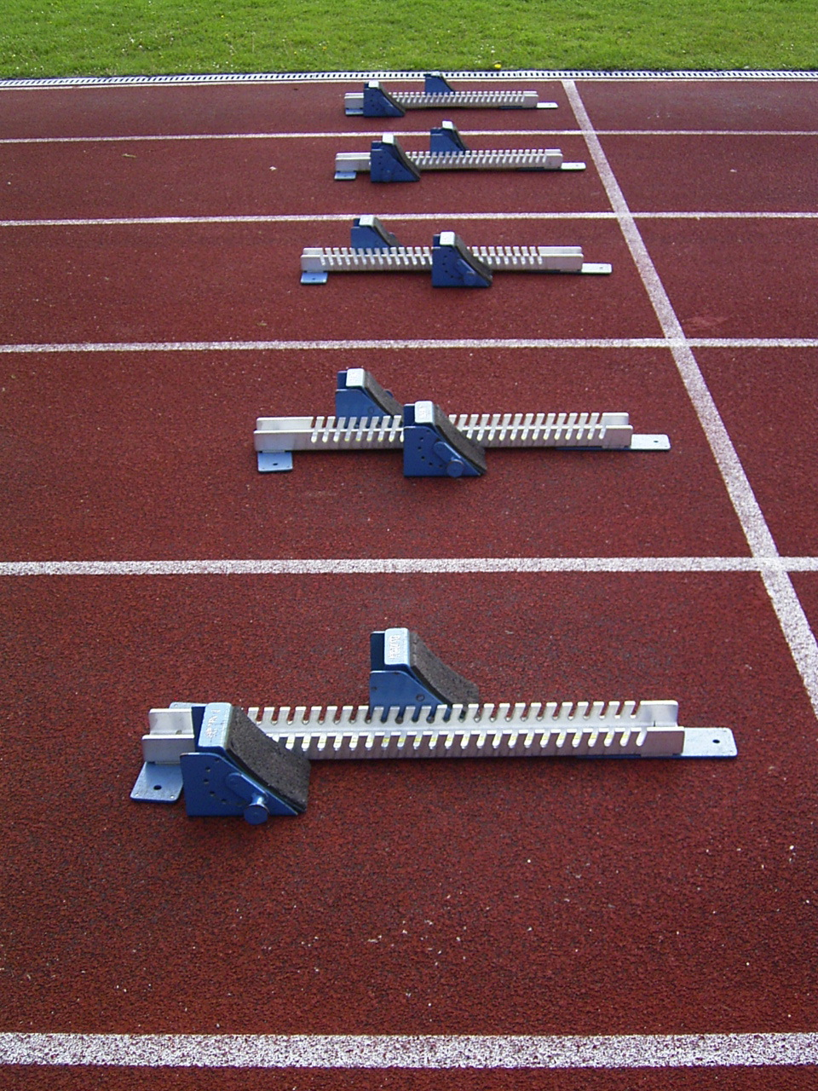
Need & Objective
Baseline situation
Sport is an important economic factor: It creates added value, employment and consumption.
The economic importance of sport cannot be measured directly from official statistics, as the sports economy is a cross-sectional sector.
Sports-related activities extend into a large number of economically relevant areas, which makes statistical recording of the sports industry a challenge.
In order to fill this gap, a pilot project to measure the economic relevance of sport was commissioned in 2008 in cooperation between BMWi and BISp: The creation of the Sports Satellite Account.
Based on the quantification of the three main pillars of sport
  Sports-related expenditure of the German population (sports consumption)
  Investments in construction, maintenance and operation of sports facilities
  Expenses for sponsoring, advertising and media rights
and in strict compliance with the ‘Vilnius definition’ of sport established at European level
the high economic importance of sport in the amount of 2.5% of the total domestic gross value added was de facto proven for the first time in 2010. This corresponded to a volume of 58.3 billion euros.
Since then, this measurement has been continued regularly in an SSA monitoring.

Slide 7
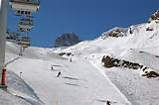

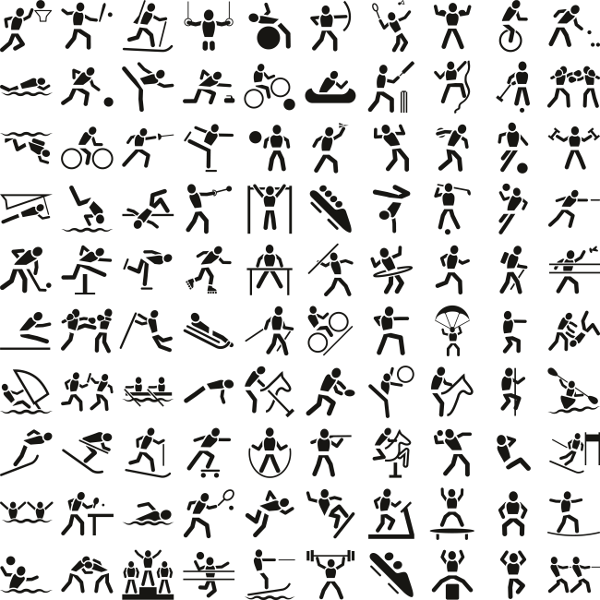

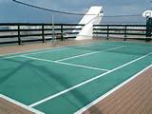

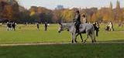


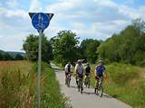
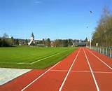

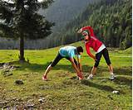
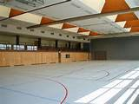
THE GERMAN SSA CONTAINS EXTENSIVE DATA
Differentiated age groups and sports intensities
71 sports and sports clusters
75 Sports facilities & opportunities
up to 88 sponsoring sectors

Slide 8
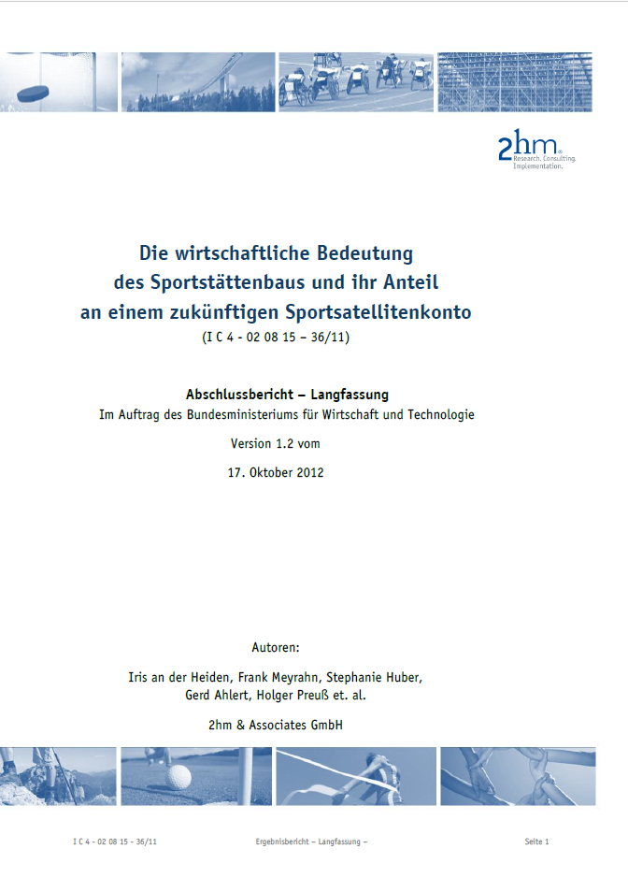

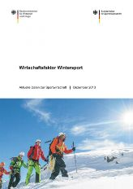
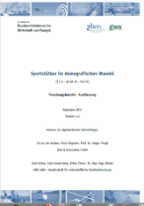
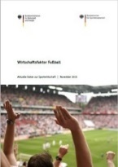

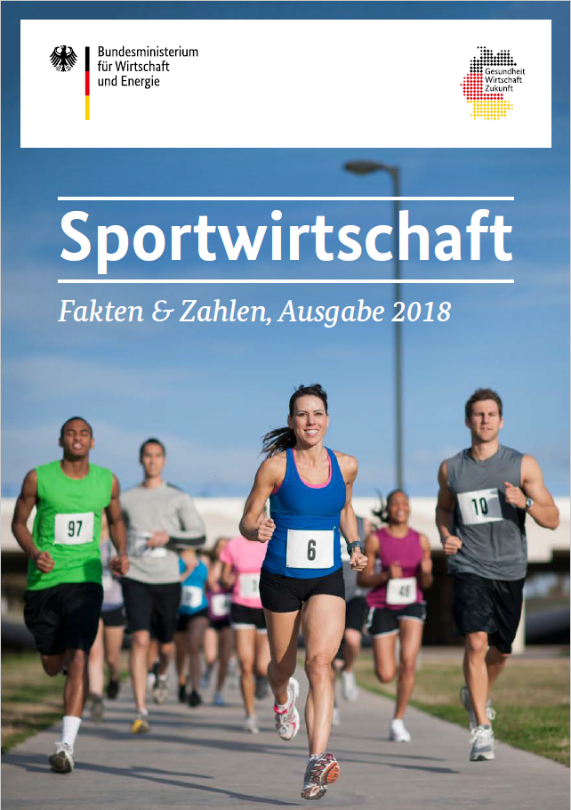
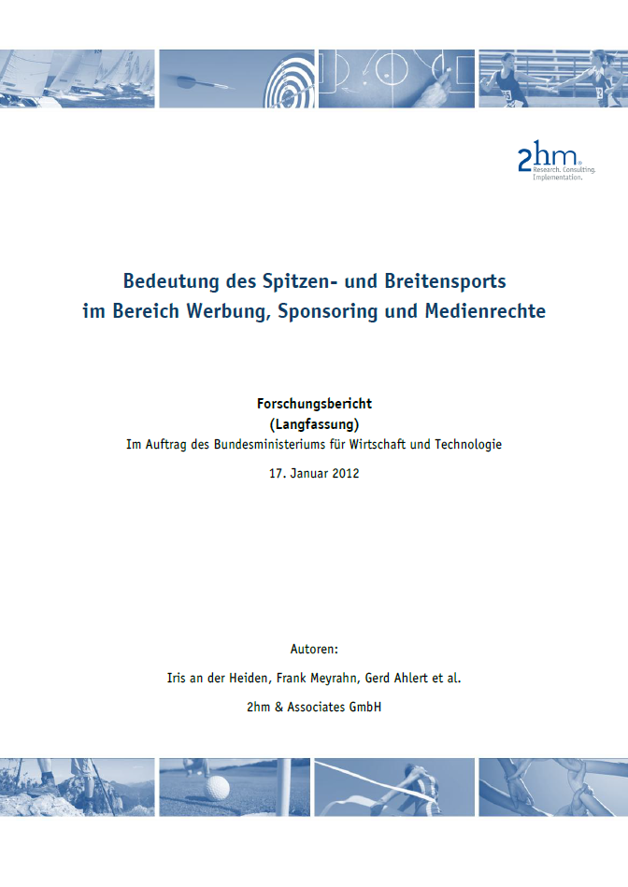

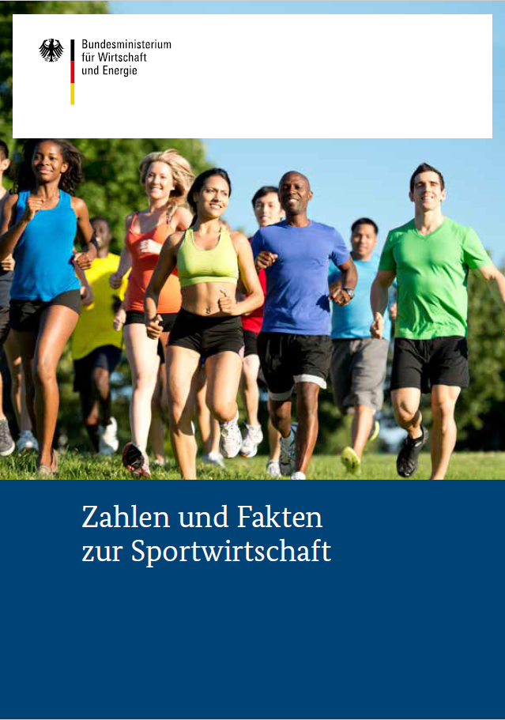
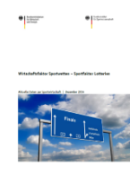
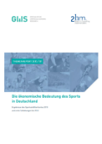
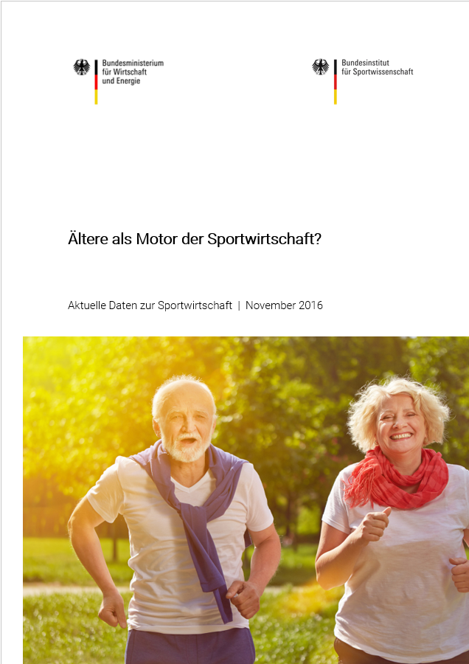
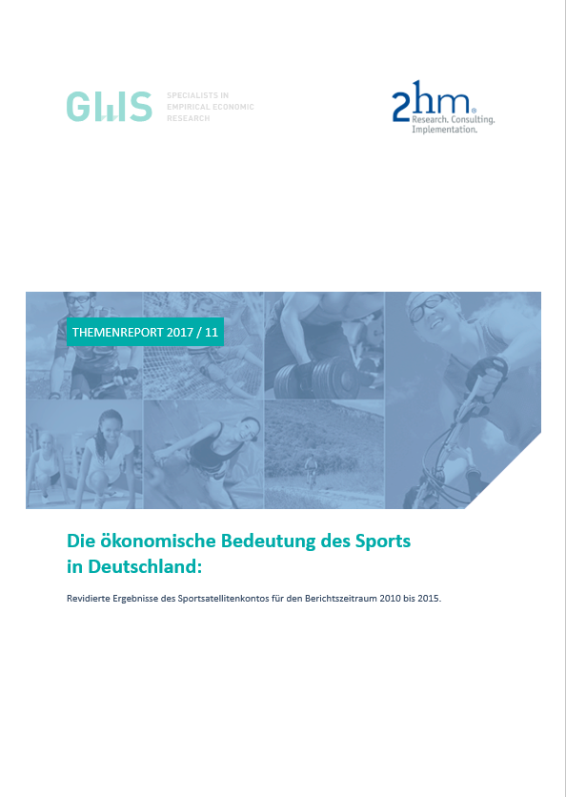
Publications of the SSA
Grundlagenstudie zum Sportstättenbau
Ergebnisse zum SSK aus VGR-Perspektive - 2008
Wirtschaftsfaktor Wintersport
Sportstätten im demografischen Wandel
Wirtschaftsfaktor Fußball
Wirtschaftsfaktor Outdoorsport
Sportwirtschaft
Fakten & Zahlen, Ausgabe 2018
01/2012
10/2012
09/2013
12/2014
08/2015
11/2016
01/2018
10/2012
05/2013
01/2014
12/2014
11/2015
11/2017
05/2018
Grundlagen-studie zu Werbung, Sponsoring, Medienrechten
Grundlagen-studie zum Sportkonsum privater Haushalte
Zahlen und Fakten zur Sportwirtschaft
Wirtschaftsfaktor Sportwetten
Ergebnisse zum SSK aus VGR-Perspektive - 2010
Ältere als Motor der Sportwirtschaft?
Ergebnisse zum SSK aus VGR-Perspektive - 2015

Slide 9
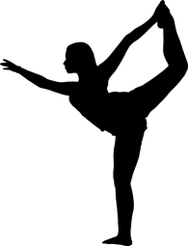

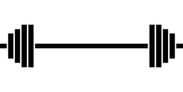
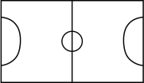


THE ECONOMIC IMPORTANCE OF SPORT
10001
110100
110100
11011101010110111001001000010
00001
€
2,3%
€
€
GDP
GDP
Sports

Slide 10
Selected key figures of the SSK
The economic factor of sport in Germany has grown from 2010 to 2015. However, the increase in the overall economy is below average.
The economic performance of the cross-sectional industry Sport is comparable to the gross value added of the transport sector (total passenger and freight transport).
Sports-specific production in Germany will amount to around 114 billion euros in 2015. Services in particular have seen a sharp increase since 2010.
Key Figures
In Comparison
Grown
109,8
In bill. €
114,2
2010
2015
+/-
Cross-sectional industries
Information & Communication
Banks, insurance companies, real estate, etc.
Construction industry
Manufacturing industry (without building.)
Transport, hotels and restaurants
Trade
Sport (Other.)
Public and personal service providers
Sportsrelated, bill. €
66,7
69,8
+4,0%
GDP
% of Total
2,6
2,3
Selected economic sectors
58,3
60,6
+3,9%
Anteil 2010 in %
Sportsrelated, bill. €
Anteil 2015 in %
Added Value
% of Total
2,5
2,2
Sportsrelated, bill. €
1.372
1.242
-9,5%
Employment
% of Total
3,3
2,9

Slide 11





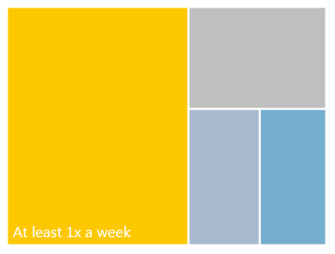
Frequency and structure of sports activities
More than half of the population is practicing
sports at least once a week, but 25 percent only occasionally engage in sports activities. 18% never.
Men and women differ on the phases of their lives, in part clearly in their regular sporting activities.
The top 10 of the adult sports (16+years).
High sports activity
In many sports
And life phases
2015 |  |  | 2010
Ranking 2015 |  | Active, population (16+ years) in % | Rang | Active, population (16+ years) in %
1 | Swimming | 37% | 2 | 31%
2 | Cycling | 34% | 1 | 34%
3 | Running/Jogging | 25% | 4 | 25%
4 | Hiking | 24% | 3 | 27%
5 | Fitness | 24% | 5 | 17%
6 | Bowling | 20% | 6 | 16%
7 | Gymnastics | 17% | 8 | 14%
8 | Soccer | 14% | 11 | 11%
9 | Health sport | 12% | 9 | 14%
10 | Dancing | 12% | 13 | 11%
18%
Never
57%
13%
12%
At least 1x
a year
At least 1x
a month
years

Slide 12
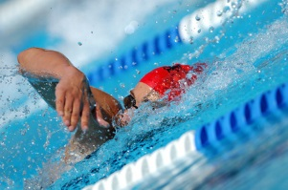

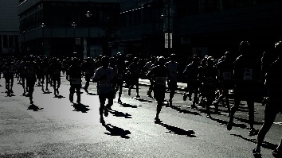
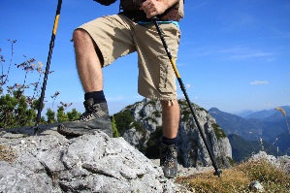
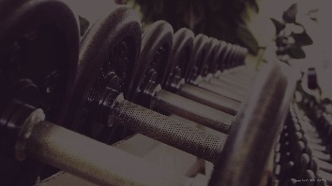
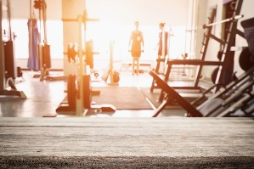
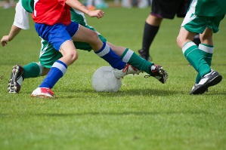

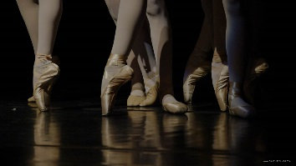
Sport takes place mainly at a regional / local level
Swimming
Cycling
Running/Jogging
Hiking
Fitness
Regional
Regional / Holiday
Regional
Day Trip/Holiday
Regional
Bowling
Gymnastics
Soccer
Health sport
Dancing
Regional
Regional
Regional
Regional
Regional

Slide 13



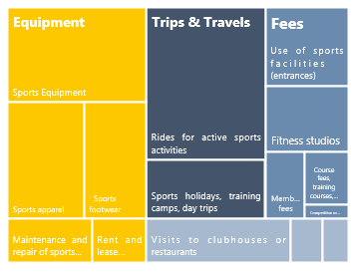
Sports with the highest consumption, consumption patterns & fans
Sports consumption is diverse. 21 percent of the active sports consumption are accounted for by the journey to the Sport. Households spent a total of € 60 billion.
Expenses for sports interest: Become annual 9.1 billion euros were consumed for sports interest.
Adult sportswomen and sportsmen in Germany
spend the most money for fitness sports in 2015.
Top Sports
Sports expenditure: Consumption patterns
Fans
15%
7%
21%
6%
…davon
58%
10%
8%
8%
3%
3%
4%
Around the Sports
1%
Insurances
in Mio. €/Jahr
3%
7%
5%
Others

Slide 14
The Most expenditures for sport take place at a regional level
Consumption Category (adults, 16+) | Expenditure amount | Place of expenditure (tendentially)
Sports Equipment | ++++ | Regional, Online
Sports Footwear | +++ | Regional, Online
Sports Apparel | +++ | Regional, Online
Sports food | + | Regional, Online
Products for prevention | + | Regional, Online
Books and magazines | + | Regional, Online
Computer, game software, video/audio material | + | Regional, Online
Insurances | + | Regional, Online
Competition or participation fees | + | Regional, National
Trips for Sport Competitions | + | Regional, National
Trips for Training | ++++ | Regional
Use of sports facilities (entrances) | +++ | Regional
Fitness studios | +++ | Regional
Expenditures in clubhouses or restaurants | +++ | Regional
Membership fees in Sports Clubs | + | Regional
Course fees, self-financed trainings or performance diagnostics | + | Regional
Medical services | + | Regional
Care, repair, maintenance (Equipment) | ++ | Rather regional
Rental and lending expenses | + | Rather regional
Sports Competitions Accommodation | + | Rather National
Day Trips for sport | ++ | Rather National
Sport vacations, Training Camps | ++ | National
Share Online Trade „Fashion“ in 2015: 20,7% (kpmg)

Slide 15
By far the most sports is self-organized (and grassroot)
Do you actively practice one or more of your sports in a sports club?
2017; n=1,000, Population 16+

Slide 16
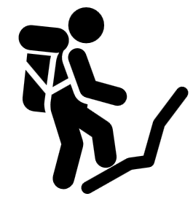



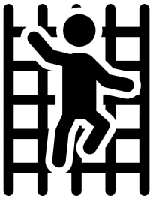
Degree of organization – example Outdoorsports
representing approx. 25% of the private household expenditures for sports,
Outdoorsports is not organized at all.
Mountaineering
Running/Jogging
6%
of Population
1%
At the club
25%
of Population
3%
At the club
7%
Every Week
79%
Less than
1x
per month
68%
Every Week
7%
Less than
1x
per month
Canoeing and kayaking
Cycling
4%
of Population
3%
At the club
34%
of Population
1%
At the club
7%
Every Week
69%
Less than
1x
per month
46%
Every Week
15%
Less than
1x
per month
Climbing/Bouldering
Hiking
3%
of Population
4%
At the club
24%
of Population
3%
At the club
15%
Every Week
69%
Less than
1x
per month
25%
Every Week
47%
Less than
1x
per month

Slide 17
Sports Facilities: Tops, Flops & Investments
The TOP 10 sports facilities according to
economic importance: municipal sports facilities
and gyms are associated with the highest costs.
The number of sports facilities and sports opportunities is limited in the relatively constant overall in recent years. Strong developments
was seen in laser tag facilities and fitness centers. Ski facilities and billiard rooms, on the other hand, declined.
The economic importance of the sports facilities in
Germany is stable at around 24.5 billion euros.
However, operating costs increase and construction costs decrease.
Evergreens
Trends
Investments
24,4
in bill. €/year
24,5
in Mio. €/Jahr
207%

Slide 18
Sponsoring, Advertising & Media Rights
The focus of sports sponsoring is on grassroot sports,
is, however, increasingly shifting towards top-class sport.
Expenses in top sponsoring and for media rights were able to increase by more than 20 percentage points between 2010 and 2014. The popular sport sponsoring could not keep up with this increase.
Soccer is the main recipient of expenditure.
Increased sponsoring
Different degrees
Soccer is booming
in mill. €/year
in mill. €/year
2.303
1.101
Soccer | Other Sports

Slide 19



holistic approach may be Eye opening – example soccer
"Emotional" media perception of sport as an economic factor
All other sports
Professional Soccer

Slide 20
holistic approach may be Eye opening – example soccer
Economic Factor Soccer
Sports Satellite Account Germany 2010
CONSUMING OF PRIVATE HOUSEHOLDS
(to scale, source SSA 2010)
94%
6%
Consumption professional soccer
Consumption of all other sports,
incl. grassroot soccer

Slide 21

holistic approach may be Eye opening – example soccer
Economic Factor Soccer
Sports Satellite Account Germany 2010
(to scale, source SSA 2010)
30%
30%
18%
11%
6%
Sponsoring & media rights
4%
Consumption private households
Consumption private households
Sponsoring
Soccer Stadiums
Sport fields
„Grassroot“ Soccer
Professional Soccer

Slide 22
Why it is important to have an differentiated view on sports
Many positive outcomes of sports
Different ages – different sports
Different stakeholder – different sports
Because sports is versatile
Different sexes – different sports
Different measurements – different sports
Different cultures – different sports
Different regions – different sports

Slide 23
Top 5 Sports by age
Swimming
Fitness
Running/Jogging
Cycling
Hiking
% of
population 16+

Slide 24
Top 5 Sports of age groups
20-29 years | 40-49 years | 60 years+
Fitness | Swimming | Cycling
Running/Jogging | Cycling | Hiking
Swimming | Fitness | Swimming
Cycling | Running/Jogging | Gymnastics
Soccer | Hiking | Health Sports

Slide 25
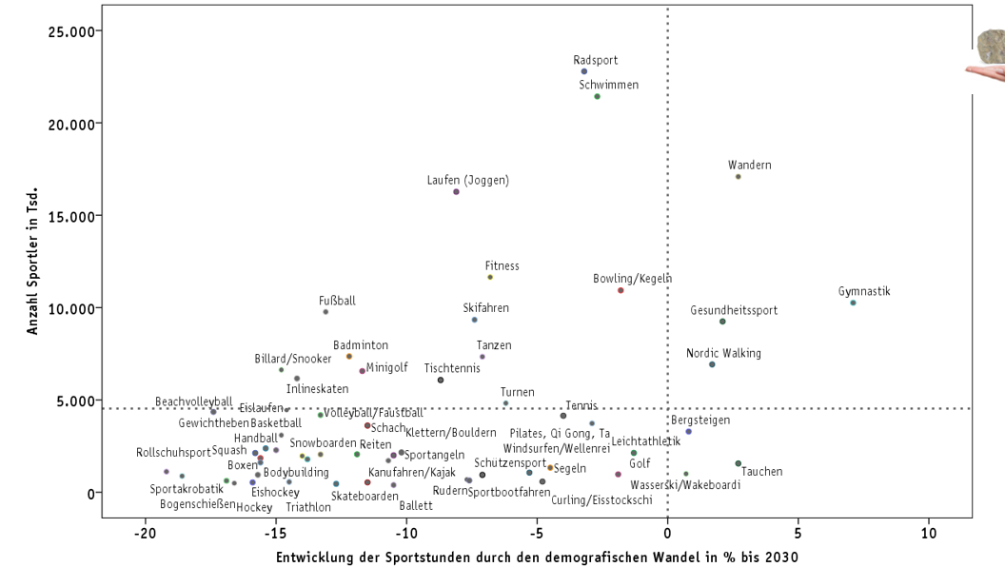
Demographical change may change Sports Structure

Slide 26
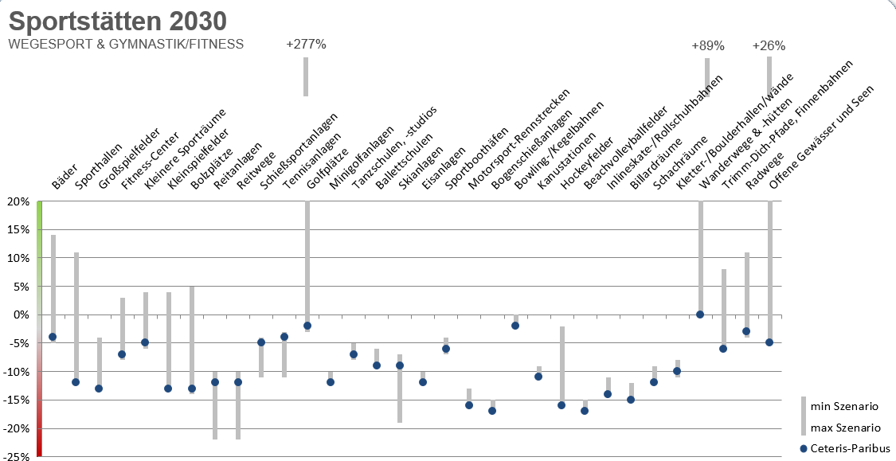
And need for Sports infrastructure as well

Slide 27
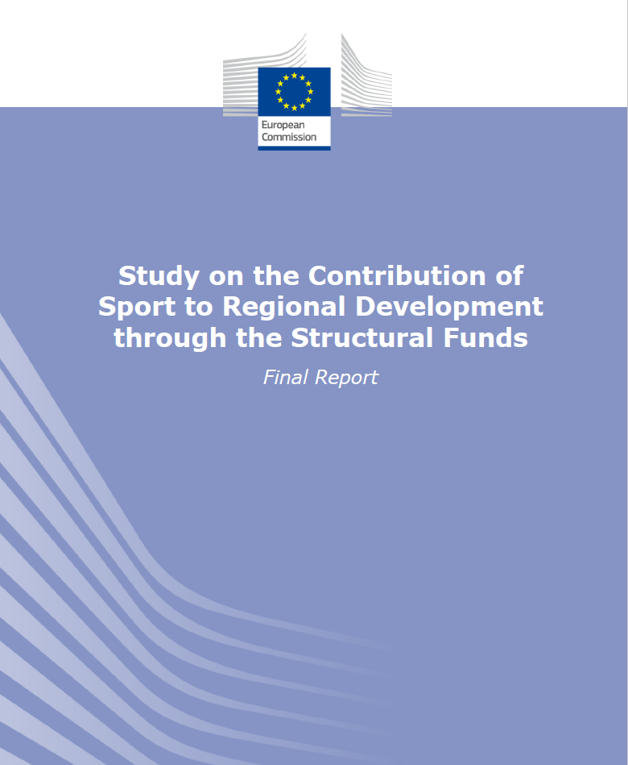
Secondary literature
Study on the Contribution of Sport to Regional Development
through the Structural Funds
European Commission 2016
Direct Impacts on Employment
2. Innovation
3. Sports Infrastructure & Regional Strategy
4. Sport & Regional Strategy
5. Sport & Urban Regeneration & Development
6. Sport & Rural Development
7. Integration with Tourism Strategy
8. Integration with Cultural & Creative Industries
9. Training of Sport Stuff – Direct Skills Development
10. Employability & Transversal Skills
11. Contribution to health Improvements
12. Contribution to the Environment
13. Social Cohesion & Reconsiliation
2007-2016: 229 sport and physical activity projects (33 Case Studies) across Europe

Slide 28
Study on the Contribution of Sport to Regional Development through the Structural Funds
Case 1: Bike Route of Friendship and Health
Case 2: Fit for Business
Case 3: Mikkeli City Centre Walking & Cycling Project
Integration with Tourism Strategy | Employability & Transversal Skills | Sport & Urban Regeneration & Development
Slovenia, Italy, Croatia | Netherlands, Germany; 2010-2013 | Finland; 2015-2016; initially derived from local population
Goals (e.g.): promote active tourism, recreation and friendship among peoples and countries | Goals (e.g.): Improvement of health & creating networks between firms (SME`s) and sports clubs | Goals (e.g.): Social development (health, well-beeing), economic development (spend more time and money in town centres), sustainable development (air quality)
Process: Transform former railway line running for 120 km from Trieste in Italy to Poreč in Croatia to create a cycling route; | Process: Check up, offering activities in the work place (breaks, immed. after work), evaluation | Process: rebuilding the existing road network in the town centre; Steering Group (shopkeepers, sport associations, walking/cycling groups, sport-related businesses (e.g. cycle shops) and policymakers)
Annually 300.000 visitors of facilities, constantly growing (Croatia) Helped to promote the Istria region as a region of region of heritage, recreation and health New job opportunities in tourism services (accommodation, restaurants, domestic products, shops, souvenirs) | More activity: 47% of empl. are active 2h every day (Germany, 38% before) Increase in employee satisfaction & Motivation Improved eating habits – daily fruits (88% in NL, 67% before) | - Still ongoing while publication of report

Slide 29
Study on the Contribution of Sport to Regional Development through the Structural Funds
Case 1: Bike Route of Friendship and Health
Case 2: Fit for Business
Case 3: Mikkeli City Centre Walking & Cycling Project
Integration with Tourism Strategy | Employability & Transversal Skills | Sport & Urban Regeneration & Development
Slovenia, Italy, Croatia | Netherlands, Germany; 2010-2013 | Finland; 2015-2016; initially derived from local population
Goals (e.g.): promote active tourism, recreation and friendship among peoples and countries | Goals (e.g.): Improvement of health & creating networks between firms (SME`s) and sports clubs | Goals (e.g.): Social development (health, well-beeing), economic development (spend more time and money in town centres), sustainable development (air quality)
Process: Transform former railway line running for 120 km from Trieste in Italy to Poreč in Croatia to create a cycling route; | Process: Check up, offering activities in the work place (breaks, immed. after work), evaluation | Process: rebuilding the existing road network in the town centre; Steering Group (shopkeepers, sport associations, walking/cycling groups, sport-related businesses (e.g. cycle shops) and policymakers)
Annually 300.000 visitors of facilities, constantly growing (Croatia) Helped to promote the Istria region as a region of region of heritage, recreation and health New job opportunities in tourism services (accommodation, restaurants, domestic products, shops, souvenirs) | More activity: 47% of empl. are active 2h every day (Germany, 38% before) Increase in employee satisfaction & Motivation Improved eating habits – daily fruits (88% in NL, 67% before) | - Still ongoing while publication of report

Slide 30
Summary
Sport as an economic factor for regional development
Although effects of sports are often measured on a superior resp. national level,
sports and related consuming as well as investments directly affects the sportsman's immediate environment.
Sport as a social factor for regional development
Concerning health or with regard to social integration, the potential of sport for regional development is even more evident.
What is needed
For getting the most out of sports as a factor for regional development, it is urgent to consider all facets of sport (wholistic approach).
Since sports ne sports and region ne region, it is on the other hand obvious, that regional individualities and strength have to be taken into account.
Share Online Trade „Fashion“ in 2015: 20,7% (kpmg)

Slide 31
Open questions
Causality
Effect strength
Need for research
Does Sport lead to regional development, or
does regional development influence Sports?
Quantitative empirical data concerning sports as
an economic/social factor on regional level are rare.
Beyond the economical importance (measured by
SSAs) the positive effect of sports is evident but specific
But:
to what extend?
And: Which regional level?
Sports
Very likely:
Sports effects regional development
Knowledge about regional specific preferences
needs
structures
has to be achieved
(Regional) development

